Slide 1
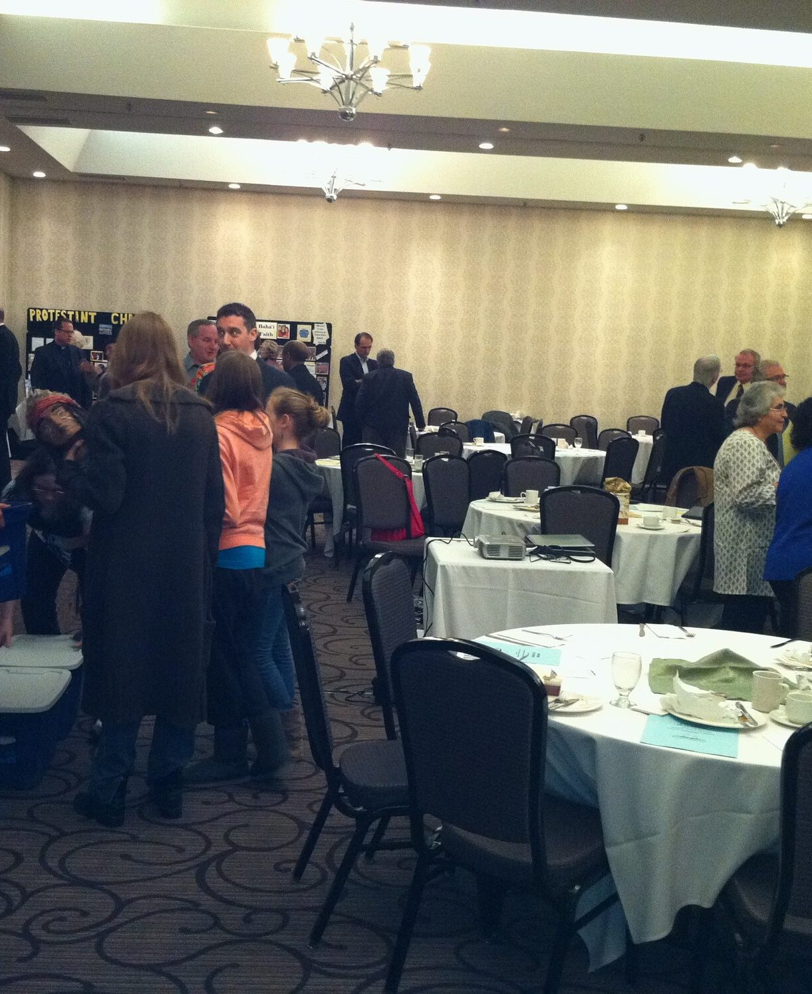

25TH ANNIVERSARY BREAKFAST
Twenty-five years at one table
Imam Abdul-Qayyum Mufti
The Rev. Dr. Mòrar Murray-Hayes, D.D.
Founding Co-Chairs, 2001
Wednesday, October 14, 2026 · Thomas Merton Centre, Oakville
Notes:
SPEAKERS: both. Welcome. ~1 min.
Whoever opens: welcome everyone, thank them for coming at 8 in the morning, and introduce the other co-founder by name.
The photograph is the Council's Interfaith Breakfast of April 2011 — faith communities set up displays side by side and spent a morning explaining themselves to their neighbours.
Suggested running order for about 39 minutes (swap freely):
AQ — your story: slides 3, 4, 5, 6 (a personal word about Mòrar), 13, 14, 15, 16 (your blank slide); then 18, 19, 21, 24, 26
Mòrar — her story: slides 7, 8, 9, 10, 11 (her blank slide); then 12, 17, 20, 22, 23
Both — slides 1, 2, 25, 27
Blank slides 11 and 16 are for anything you want to add. Delete either one if unused.

Slide 2
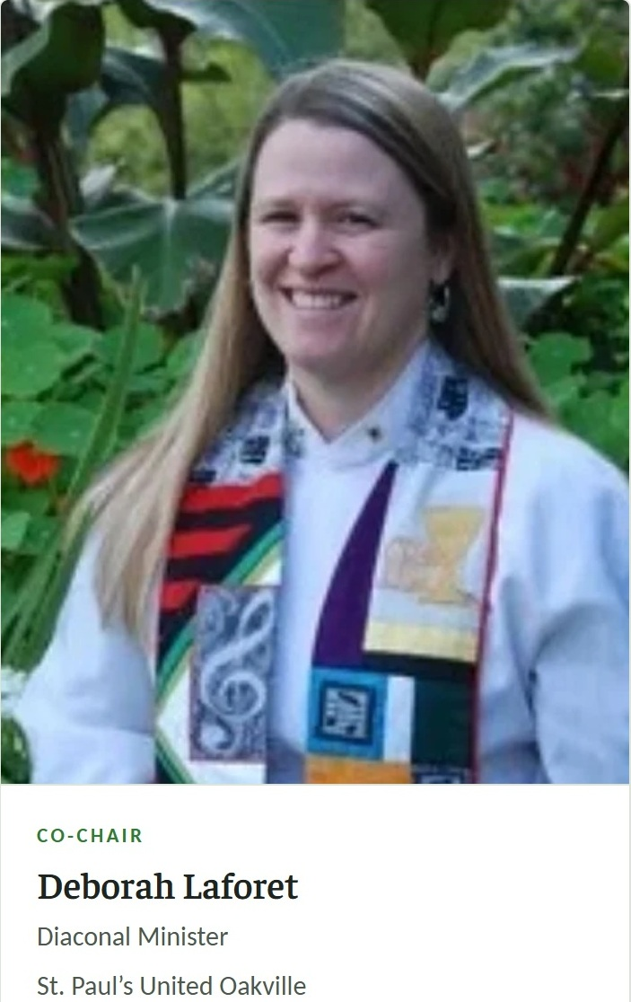
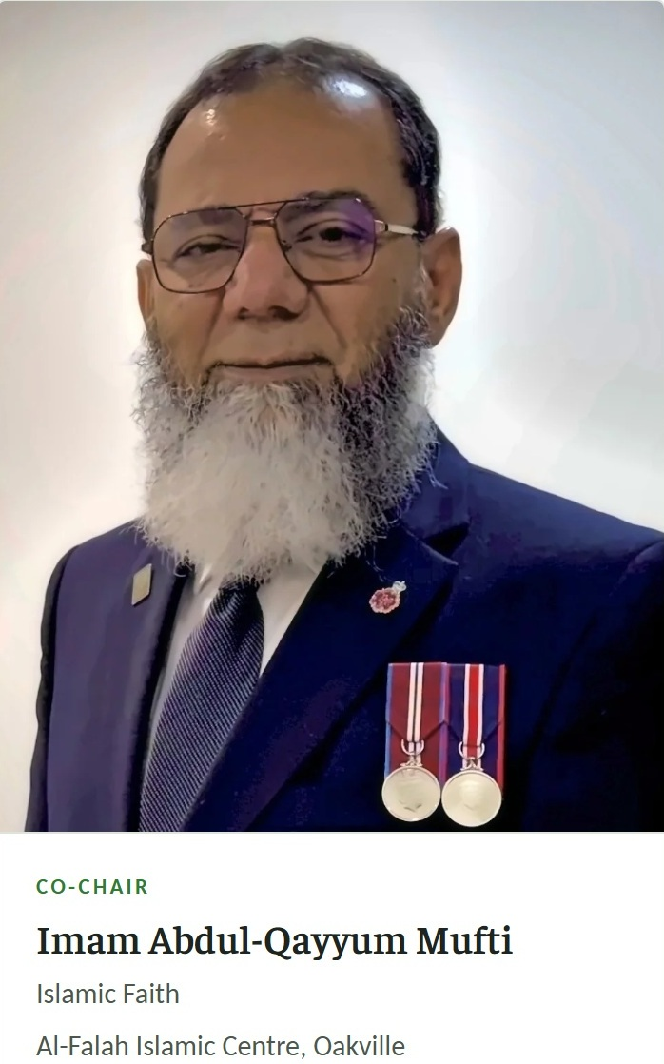
WHO IS SPEAKING
CO-CHAIRS
Notes:
SPEAKERS: both — each introduces the OTHER. ~1.5 min.
For Mòrar to say about AQ (from his published introduction): founded the Council in 2001 and was its founding Co-Chair; after a period on the Executive Committee he returned to the chair and serves as Co-Chair today; a founding member of the Halton Regional Police Service Multi-Faith Support Team for over twenty years.
For AQ to say about Mòrar (from her published introduction): a United Church Minister for over 50 years; a pioneer in the establishment of women in ordained ministry; teacher of ministers at four theological colleges; studied Judaism and Islam alongside Christianity at McGill; taught World Religions at St. Mildred's Lightbourn and Oakville Memorial.
The point to land: two of the Council's three founding Co-Chairs are still on the Council, twenty-five years on. The third, Rabbi Paul Sidlofsky, comes in on slide 5.
PRESENTER: Deb and AQ

Slide 3
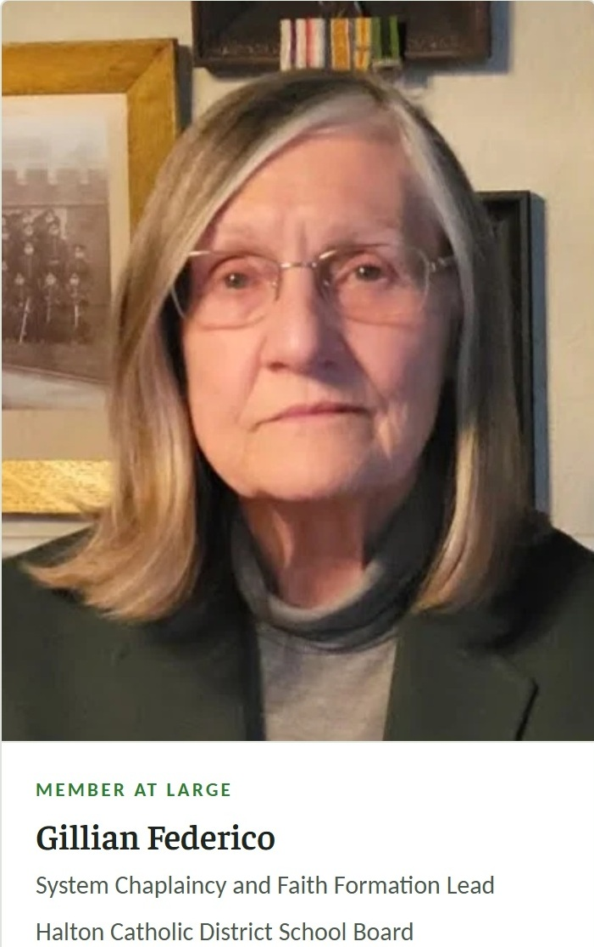
WHO IS SPEAKING
LAND ACKNOWLEDGEMENT
Notes:
SPEAKERS: both — each introduces the OTHER. ~1.5 min.
For Mòrar to say about AQ (from his published introduction): founded the Council in 2001 and was its founding Co-Chair; after a period on the Executive Committee he returned to the chair and serves as Co-Chair today; a founding member of the Halton Regional Police Service Multi-Faith Support Team for over twenty years.
For AQ to say about Mòrar (from her published introduction): a United Church Minister for over 50 years; a pioneer in the establishment of women in ordained ministry; teacher of ministers at four theological colleges; studied Judaism and Islam alongside Christianity at McGill; taught World Religions at St. Mildred's Lightbourn and Oakville Memorial.
The point to land: two of the Council's three founding Co-Chairs are still on the Council, twenty-five years on. The third, Rabbi Paul Sidlofsky, comes in on slide 5.
PRESENTER: Gillian

Slide 4
HONOURED REPRESENTATIVES
MP Anita Anand’s representative
Stephen Tanner (Chief of HRPS)
MP Sima Acan
Sue Biggs (Inspector)
MPP Stephen Crawford
Aaron Groat (Chaplain)
Mayor Rob Burton
Councillor Dave Gittings (Ward 3)
Notes:
SPEAKER: welcome the honoured representatives by name, in this order.
CHECK before the day: the spelling of every name, and whether anyone has been added. “MPP Sima Kan” and “Councillors: Dave Gittings” are as written in the draft.
PRESENTER: Deborah (left), AQ (right).
CHECK: 'MP Sima Acan' is as typed. Confirm the title (MP or MPP) and the spelling before the day.

Slide 5
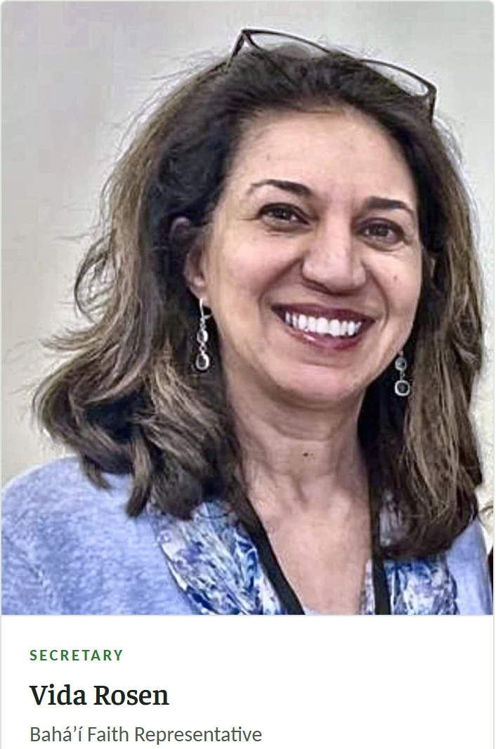
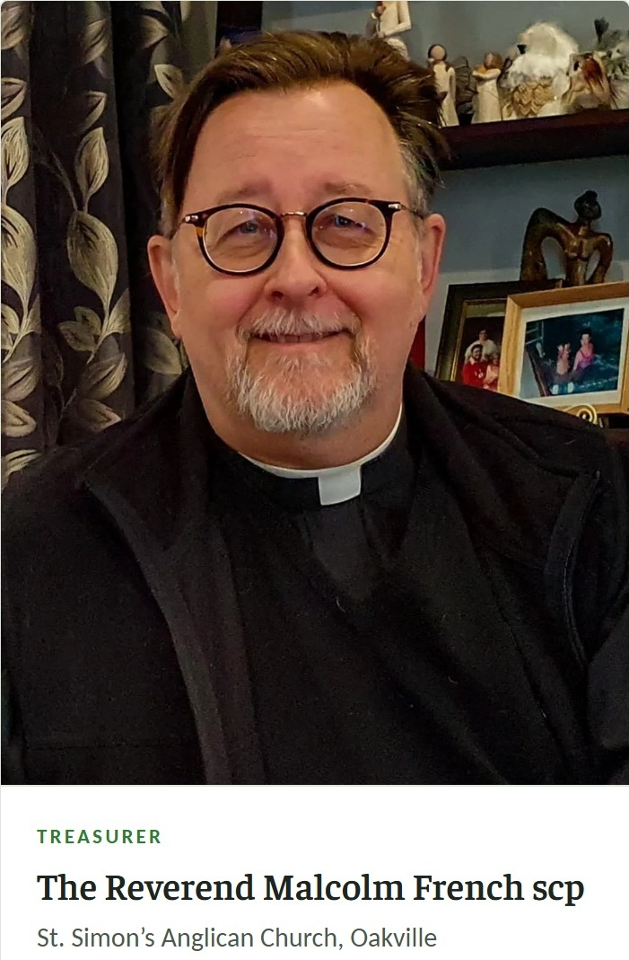
ICH EC Members
SECRETARY AND TREASURER
Notes:
SPEAKERS: both — each introduces the OTHER. ~1.5 min.
For Mòrar to say about AQ (from his published introduction): founded the Council in 2001 and was its founding Co-Chair; after a period on the Executive Committee he returned to the chair and serves as Co-Chair today; a founding member of the Halton Regional Police Service Multi-Faith Support Team for over twenty years.
For AQ to say about Mòrar (from her published introduction): a United Church Minister for over 50 years; a pioneer in the establishment of women in ordained ministry; teacher of ministers at four theological colleges; studied Judaism and Islam alongside Christianity at McGill; taught World Religions at St. Mildred's Lightbourn and Oakville Memorial.
The point to land: two of the Council's three founding Co-Chairs are still on the Council, twenty-five years on. The third, Rabbi Paul Sidlofsky, comes in on slide 5.
PRESENTER: Deborah

Slide 6
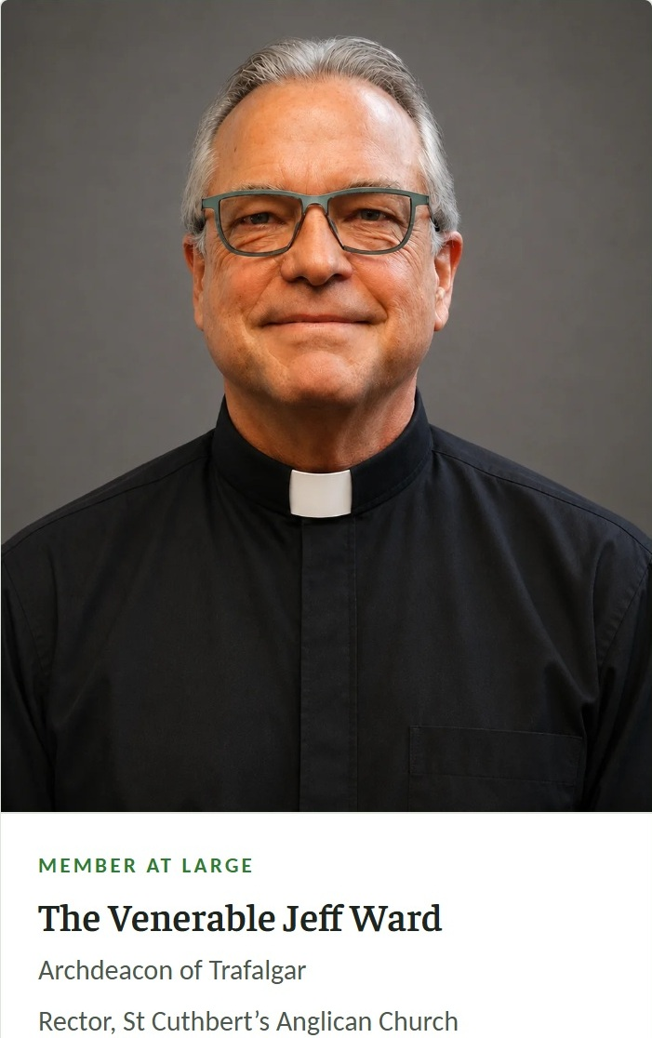
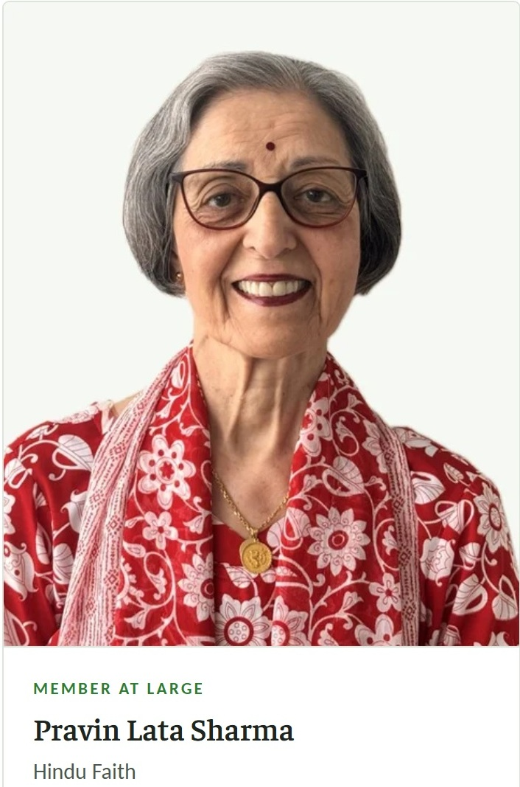
ICH EC Members
MEMBERS AT LARGE
Notes:
SPEAKERS: both — each introduces the OTHER. ~1.5 min.
For Mòrar to say about AQ (from his published introduction): founded the Council in 2001 and was its founding Co-Chair; after a period on the Executive Committee he returned to the chair and serves as Co-Chair today; a founding member of the Halton Regional Police Service Multi-Faith Support Team for over twenty years.
For AQ to say about Mòrar (from her published introduction): a United Church Minister for over 50 years; a pioneer in the establishment of women in ordained ministry; teacher of ministers at four theological colleges; studied Judaism and Islam alongside Christianity at McGill; taught World Religions at St. Mildred's Lightbourn and Oakville Memorial.
The point to land: two of the Council's three founding Co-Chairs are still on the Council, twenty-five years on. The third, Rabbi Paul Sidlofsky, comes in on slide 5.
PRESENTER: Deborah

Slide 7
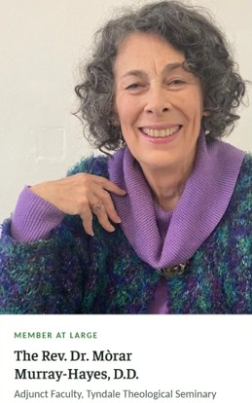
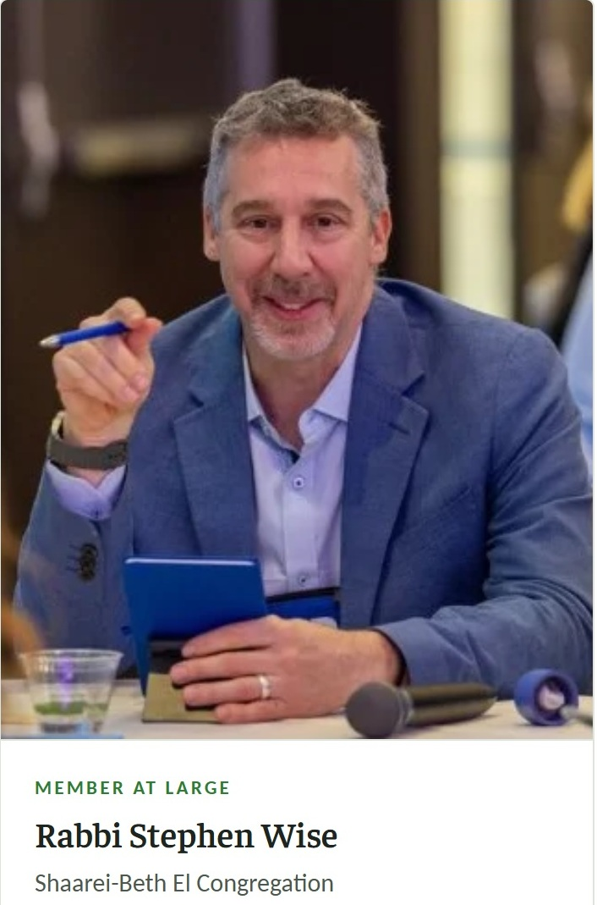
ICH EC Members
MEMBERS AT LARGE
Notes:
SPEAKERS: Deborah. ~1.5 min.
For Mòrar to say about AQ (from his published introduction): founded the Council in 2001 and was its founding Co-Chair; after a period on the Executive Committee he returned to the chair and serves as Co-Chair today; a founding member of the Halton Regional Police Service Multi-Faith Support Team for over twenty years.
For AQ to say about Mòrar (from her published introduction): a United Church Minister for over 50 years; a pioneer in the establishment of women in ordained ministry; teacher of ministers at four theological colleges; studied Judaism and Islam alongside Christianity at McGill; taught World Religions at St. Mildred's Lightbourn and Oakville Memorial.
The point to land: two of the Council's three founding Co-Chairs are still on the Council, twenty-five years on. The third, Rabbi Paul Sidlofsky, comes in on slide 5.
PRESENTER: Deborah

Slide 8

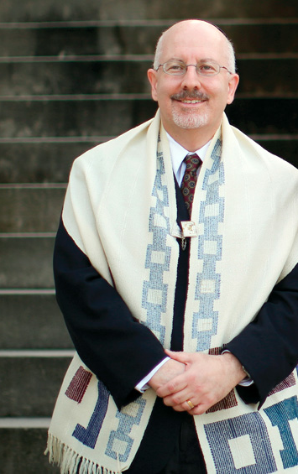

WHO HAS CHAIRED
PAST CHAIRS
Former Co-Chair
Rabbi Paul Sidlofsky
Shaarei-Beth El Congregation
Notes:
SPEAKERS: Deborah ~1.5 min.
For Mòrar to say about AQ (from his published introduction): founded the Council in 2001 and was its founding Co-Chair; after a period on the Executive Committee he returned to the chair and serves as Co-Chair today; a founding member of the Halton Regional Police Service Multi-Faith Support Team for over twenty years.
For AQ to say about Mòrar (from her published introduction): a United Church Minister for over 50 years; a pioneer in the establishment of women in ordained ministry; teacher of ministers at four theological colleges; studied Judaism and Islam alongside Christianity at McGill; taught World Religions at St. Mildred's Lightbourn and Oakville Memorial.
The point to land: two of the Council's three founding Co-Chairs are still on the Council, twenty-five years on. The third, Rabbi Paul Sidlofsky, comes in on slide 5.

Slide 9
PAST MEMBERS
Ann Mulvale (former Mayor of Oakville)
Kermin Byramjee (Sikh)
Laila Eiriksson (Baháʼí)
Ruth Victor (Town Planner)
Fr Ted Sleman (Catholic)
Nozer Kotwal (Zoroastrian)
Rev Dan Phannenhour (Anglican)
Darcey Lazerte (Anglican)
Notes:
SPEAKERS: AQ. ~1.5 min.
For Mòrar to say about AQ (from his published introduction): founded the Council in 2001 and was its founding Co-Chair; after a period on the Executive Committee he returned to the chair and serves as Co-Chair today; a founding member of the Halton Regional Police Service Multi-Faith Support Team for over twenty years.
For AQ to say about Mòrar (from her published introduction): a United Church Minister for over 50 years; a pioneer in the establishment of women in ordained ministry; teacher of ministers at four theological colleges; studied Judaism and Islam alongside Christianity at McGill; taught World Religions at St. Mildred's Lightbourn and Oakville Memorial.
The point to land: two of the Council's three founding Co-Chairs are still on the Council, twenty-five years on. The third, Rabbi Paul Sidlofsky, comes in on slide 5.
PRESENTER: AQ

Slide 10

OUR MEMBERS
Nine faith traditions, one table
Baháʼí
Buddhism
Christianity
First Nations Spirituality
Hinduism
Islam
Judaism
Sikhism
Zoroastrianism
Christianity at our table includes Protestant and Catholic members. Everyone comes as themselves, and no one is asked to be anything else.
Notes:
SPEAKER: Vida introduces and says Bahai, then other EC members with Stephen to do right hand column ~1 min.
The eight, in the Council's published order: Baháʼí · Buddhism · Christianity (Protestant and Catholic) · Hinduism · Islam · Judaism · Sikhism · Zoroastrianism.
The discovery the Council keeps coming back to (its own words): "Along our journey of discovery we have found that despite the many different practices and rituals of our faiths, the essence of our core values is the same." The Golden Rule — treat others as you would wish to be treated — is shared by every tradition at the table.

Slide 11
IN EVERY TRADITION
The Golden Rule
Hinduism (Pravin Sharma)
Zoroastrianism (Kermin Byramjee)
This is the sum of duty: do not do to others what would cause pain if done to you.
Do not do unto others whatever is injurious to yourself.
Buddhism (Stephen Wise)
Sikhism (Pravin Sharma)
Treat others not in ways that you yourself would find hurtful.
I am a stranger to no one; and no one is a stranger to me.
Indeed, I am a friend to all.
Judaism (Stephen Wise)
Islam (A. Q. Mufti)
What is hateful to you, do not do to your neighbour. This is the whole Torah; all the rest is commentary. Go and learn it.
Not one of you truly believes until you wish for others
what you wish for yourself.
First Nations Spirituality (Stephen Wise)
We are as much alive as we keep the earth alive.
Notes:
SPEAKER: Vida introduces and says Bahai, then other EC members with Stephen to do right hand column ~1 min.
The eight, in the Council's published order: Baháʼí · Buddhism · Christianity (Protestant and Catholic) · Hinduism · Islam · Judaism · Sikhism · Zoroastrianism.
The discovery the Council keeps coming back to (its own words): "Along our journey of discovery we have found that despite the many different practices and rituals of our faiths, the essence of our core values is the same." The Golden Rule — treat others as you would wish to be treated — is shared by every tradition at the table.
Seven of the nine traditions are on this slide. Baháʼí and Christianity are not - add them, or say so when you present it.

Slide 12
BEFORE WE EAT
Blessing of Food
IN HEBREW
בָּרוּךְ אַתָּה, יְיָ אֱלֹהֵינוּ, מֶלֶךְ הָעוֹלָם, הַמּוֹצִיא לֶחֶם מִן הָאָרֶץ
TRANSLITERATED
Baruch atah, Adonai Eloheinu, melech haolam, hamotzi lechem min haaretz.
IN ENGLISH
“Blessed are You, Lord our God, King of the universe, who brings forth bread from the earth.”
Notes:
SPEAKER: Stephen ~1 min.
The eight, in the Council's published order: Baháʼí · Buddhism · Christianity (Protestant and Catholic) · Hinduism · Islam · Judaism · Sikhism · Zoroastrianism.
The discovery the Council keeps coming back to (its own words): "Along our journey of discovery we have found that despite the many different practices and rituals of our faiths, the essence of our core values is the same." The Golden Rule — treat others as you would wish to be treated — is shared by every tradition at the table.

Slide 13
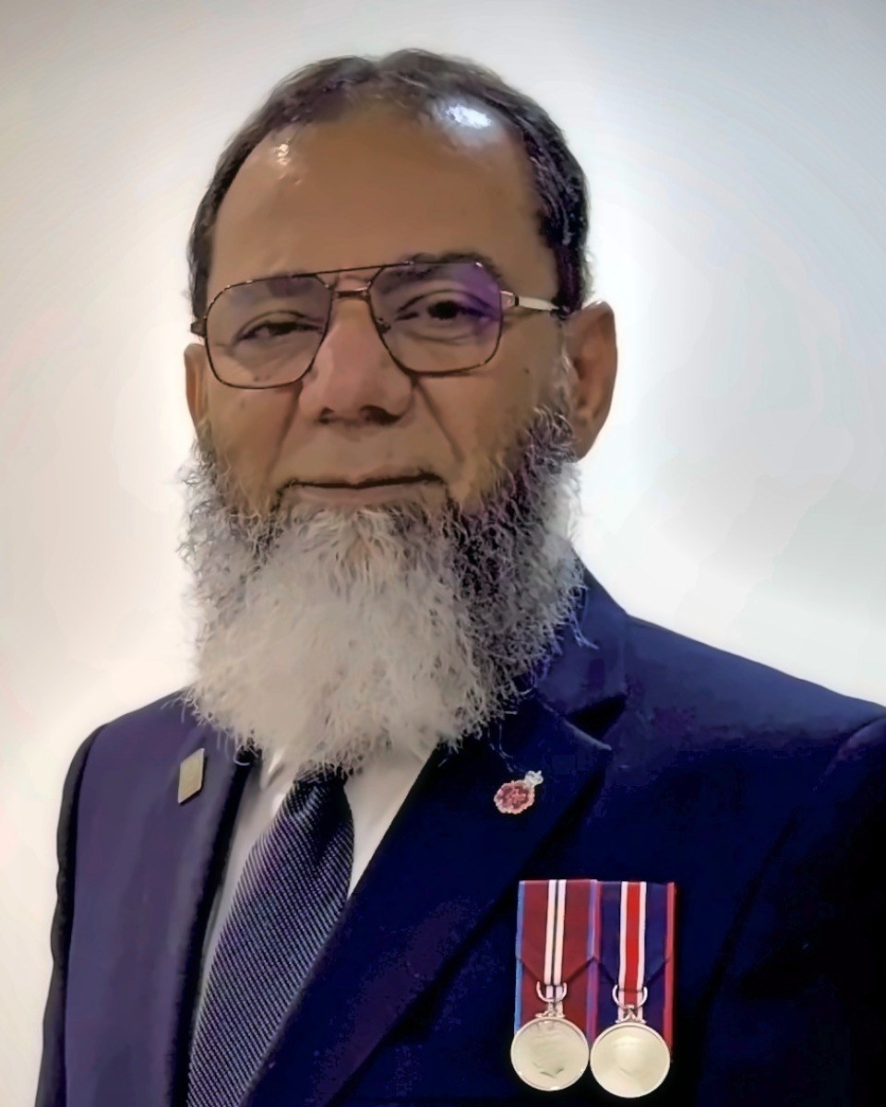
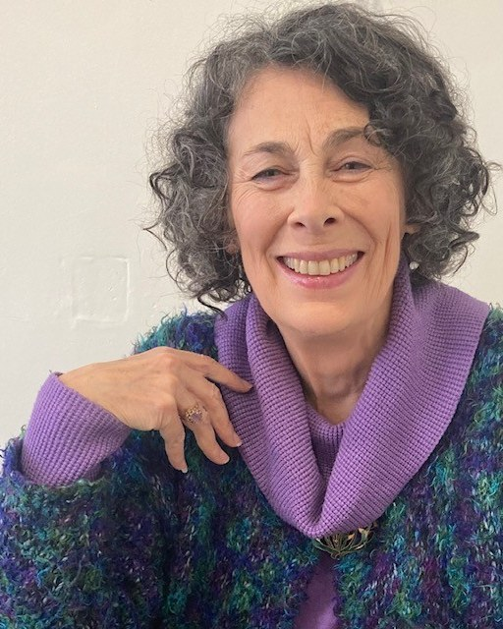
WHO IS SPEAKING
Two of our founders, still at the table
Imam Abdul-Qayyum Mufti
The Rev. Dr. Mòrar Murray-Hayes, D.D.
Islamic Faith, Al-Falah Islamic Centre, Oakville
Founding Co-Chair, 2001
Co-Chair today
United Church Minister for over 50 years
Founding Co-Chair, 2001
Member at Large today
Notes:
SPEAKERS: both — each introduces the OTHER. ~1.5 min.
For Mòrar to say about AQ (from his published introduction): founded the Council in 2001 and was its founding Co-Chair; after a period on the Executive Committee he returned to the chair and serves as Co-Chair today; a founding member of the Halton Regional Police Service Multi-Faith Support Team for over twenty years.
For AQ to say about Mòrar (from her published introduction): a United Church Minister for over 50 years; a pioneer in the establishment of women in ordained ministry; teacher of ministers at four theological colleges; studied Judaism and Islam alongside Christianity at McGill; taught World Religions at St. Mildred's Lightbourn and Oakville Memorial.
The point to land: two of the Council's three founding Co-Chairs are still on the Council, twenty-five years on. The third, Rabbi Paul Sidlofsky, comes in on slide 5.

Slide 14
2001
Together We Stand
Faith leaders across Halton, and Rev. Mòrar Murray-Hayes, accepted the invitation.
It began with two gatherings
At the Al-Falah Islamic Centre, hundreds of community members from across Halton — with the HRPS Chief and officers, the Fire Chief, the OPP, the RCMP, then Mayor Ann Mulvale, Councillors, MPs, MPPs and other dignitaries.
Together We Celebrate
Soon after, at Eid — the same people, and another full house.
Notes:
SPEAKER: AQ — your story, part 1. ~2 min.
Your own words (spelling corrected only):
"25 years ago I had arranged an interfaith program that was attended by hundreds of community members in Halton, in addition to the HRPS Chief and officers, the Fire Chief, OPP, RCMP, then Mayor Ann Mulvale, Councillors, MPs and MPPs and other dignitaries. To arrange this program I approached Rev. Mòrar Murray-Hayes and faith leaders, who graciously accepted my invitation and made this hugely successful program we called 'Together We Stand'.
Soon after, Eid day arrived. So I approached the same people and we had another houseful program with all the dignitaries attending, which we called 'Together We Celebrate'."
Both gatherings were held at the Al-Falah Islamic Centre (your note, 22 Sep 2026).
No photographs of either gathering are on record, so this slide is deliberately type only.

Slide 15
THE IDEA
Why wait for a special occasion to meet?
Why not a forum where we meet regularly — not just to meet and greet, but to learn from each other?
1
2
3
Learn
Educate
Share
from each other, around one table
our own congregations and communities
what we learn with the general public
Notes:
SPEAKER: AQ — your story, part 2. ~1 min.
Your own words (spelling corrected only):
"After that I thought: why do we have to wait for some special occasion to meet? Why not have a forum where we can meet regularly? The purpose of this meeting would not be just to meet and greet, but rather to learn from each other and then educate our respective congregations and communities, and the general public."

Slide 16
THE FOUNDING
Three Co-Chairs, and an open door
Imam Abdul-Qayyum Mufti
The Rev. Dr. Mòrar Murray-Hayes
Rabbi Paul Sidlofsky
Brought the idea
The first person I invited, who said yes with open arms
Was next to be approached with the idea, and graciously accepted
A. Q. Mufti - My first call: then Mayor Ann Mulvale. I shared the idea with her first and asked whom I should approach; she graciously gave me a few names. Once we had formed, she opened the doors of Town Hall, took the minutes of our first meeting herself, and gave us a permanent place there to meet.
Notes:
SPEAKER: AQ — your story, part 3. ~2 min. Then hand to your personal word about Mòrar (next slide).
Your own words (spelling corrected only):
"After the two programs at Al-Falah, I first went to Mayor Ann Mulvale to share my idea of forming the ICH, and asked her advice on whom I should approach. She graciously gave me a few names. I chose to go to Mòrar and Rabbi Sidlofsky.
With this in mind I approached Mòrar first, who, as usual, supported and accepted the offer with open arms. I then approached Rabbi Paul Sidlofsky and presented the idea; he also graciously accepted it, and we founded the ICH. We three became the Co-Chairs.
Thanks to then Mayor Ann Mulvale, who opened the doors of the Town Hall for us, and not only took the minutes of our first meeting herself but also gave us a permanent place in the Town Hall to conduct our meetings. We started conducting our regular monthly meetings, attended by faith community leaders and their community members on a regular basis."

Slide 17
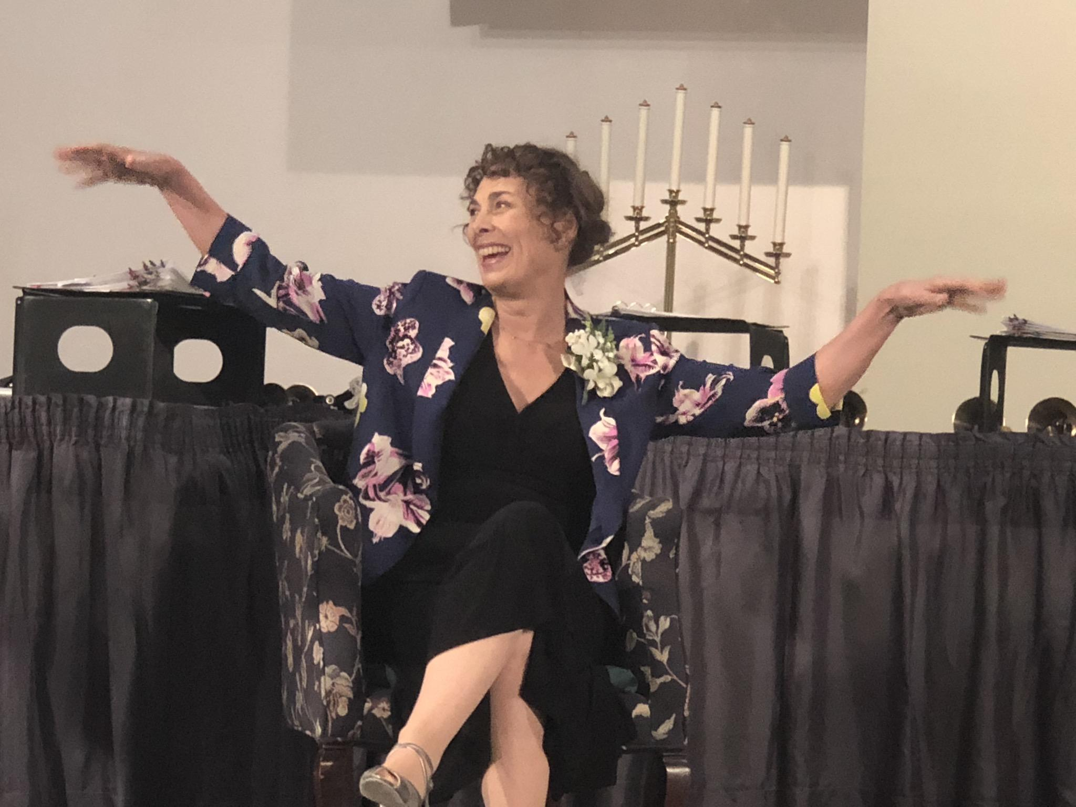
A PERSONAL WORD · AQ ON MÒRAR
The first faith leader I came to know
Always ready to listen, to understand and to support, with a wonderful smile.
From the start, she brought members of her congregation to our programs and welcomed us to hers.
Instrumental in sponsoring Syrian refugees and in welcoming the family at her Church.
Morar Murray Hayes
The first person I invited to form the ICH.
“I cherish a quarter of a century of her friendship.”
Notes:
SPEAKER: AQ — a personal word about Mòrar. ~1.5 min. Then hand over to Mòrar for her story.
Your words, reworded for speaking:
"On a personal note: Mòrar was the first faith leader I came to know and to work with. She has always been such a gracious person, ready to listen, to understand and to support, and always with a wonderful smile.
From the very beginning, she came to our interfaith programmes with a whole group from her congregation. She arranged interfaith programmes at her own church, and invited me and the Muslim community to several of her church's celebrations.
She was instrumental in sponsoring Syrian refugees, and arranged a programme to welcome the family.
One thing connected me to her church from day one: it was built in the same year I was born. Now, don't try to guess my age!
And last, but by no means least, she was the first person I invited to form the ICH. I cherish a quarter of a century of her friendship."
Photo: from your file 'GG and Mufti Pravan Morar'. The occasion and date are not recorded, so only the two of you are named on the slide.

Slide 18
MÒRAR’S STORY
One of the pioneers, long before this table
A United Church Minister for over 50 years, and a pioneer in the establishment of women in ordained ministry.
At McGill, among students from a wide spectrum of faith traditions, she studied Judaism and Islam as well as Christianity.
A doctorate at Princeton Theological Seminary; later an honorary doctorate from McGill.
Teacher of ministers at four theological colleges.
Notes:
SPEAKER: Mòrar — your story, in your own words. ~2 min.
The bullets are from your published introduction on the Leadership page. Everything else is yours to tell. Prompts only:
• How studying Judaism and Islam at McGill shaped the way you meet other faiths.
• What it was like to be among the first women in ordained ministry — and what that taught you about being new at a table.
• What went through your mind when AQ first came to you about Together We Stand.
Your introduction also says: "Mòrar's commitment to deep interfaith relationships and her ease of engaging diverse theological perspectives was formed by her education at McGill University."

Slide 19
MÒRAR’S STORY
Over fifty years of ministry
Teaching
Coaching
Preaching
A teacher of ministers at four theological colleges. Today, Adjunct Faculty at Tyndale Theological Seminary.
A coach of congregations in transition, for both the United and Lutheran churches. A mentor to many.
Preaching described as energetic and quirky, and masterful storytelling.
“She assists others to think spiritually about the world and life.”
From Mòrar’s published introduction, Interfaith Council of Halton
Notes:
SPEAKER: Mòrar — your story, continued. ~1.5 min.
Every line on this slide is from your published introduction (Leadership page). The rest is yours to tell. Prompts only:
• A congregation in transition you coached — what it taught you about change in a community.
• What you try to give the ministers you teach.
• A story you tell often, and why.

Slide 20
DECEMBER 2009 · MÒRAR’S STORY
Writing the rules of the table
THE FIVE WHO WROTE IT
1
Decisions by consensus
Mervyn Russell
How the Council makes its decisions.
Laila Eirksson
Stephen Wise
2
Never lose a faith group
Donna Martin
“With care never to lose any faith group over a matter of conscience.”
Mòrar Murray-Hayes
Approved as a final draft for the September 2010 AGM. · From the Council’s Our History page
Notes:
SPEAKER: Mòrar. ~1.5 min.
From the Our History page: in December 2009 Mervyn Russell, Laila Eirksson, Stephen Wise, Donna Martin and Mòrar Murray-Hayes prepared the Council's constitution — decisions by consensus, "with care never to lose any faith group over a matter of conscience". Approved as a final draft for the September 2010 AGM.
Prompts only:
• Why consensus rather than a vote, for a table of many faiths.
• A time that rule was tested, and what the Council did.

Slide 21
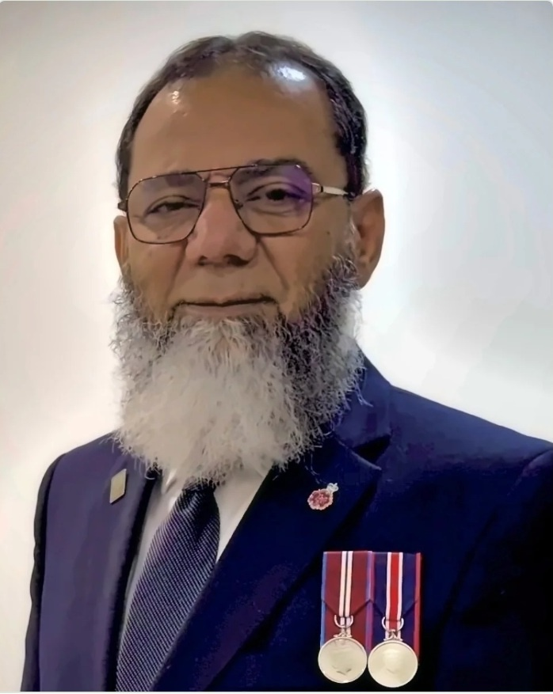
A PERSONAL WORD · MÒRAR ON AQ
A pillar of this community
Served Halton and Peel for over thirty years as an IT specialist, a certified Project Manager, and a social and community activist.
A member of Oakville’s Al-Falah Islamic Centre, he bridges communities by interpreting the Muslim faith for police services, school boards and governments.
Founded the Interfaith Council of Halton in 2001, and serves as Co-Chair today.
Imam Abdul-Qayyum Mufti
Mobilized the community to raise $5 million for Mississauga healthcare, through walks and virtual skydiving.
Notes:
SPEAKER: MÒRAR — introducing AQ. About 1 minute across these two slides.
Your words:
Community pillar: he has served Halton and Peel for over thirty years as an IT specialist, a certified Project Manager, and a social and community activist.
A member of Oakville’s Al-Falah Islamic Centre, he bridges communities by interpreting the Muslim faith for police services, school boards and governments.
Council founder: he founded the ICH in 2001 and serves as Co-Chair today.
Master fundraiser: he mobilized the community to raise $5 million for Mississauga healthcare, through walks and virtual skydiving.
Gracious when we stumbled in following the rituals. Persistent at staying at the table.

Slide 22
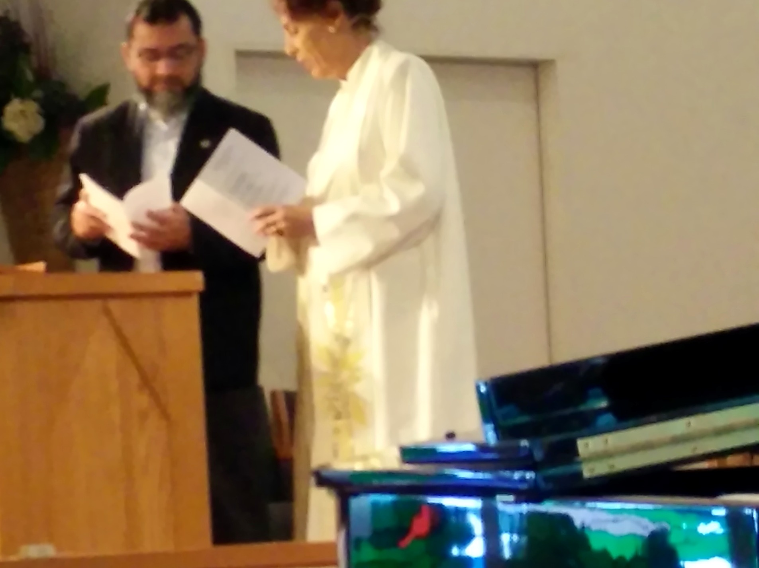
A PERSONAL WORD · MÒRAR ON AQ
A chauffeur, a teacher, a friend
Gracious when we stumbled in following the rituals.
Persistent at staying at the table.
And along the way, he studied to become Imam Mufti!
I first met Mufti as a chauffeur, bringing a speaker to our church. Now I know him as a teacher, a mentor and a friend.
With Mòrar, at Abraham’s Children celebration
“Please welcome Imam Abdul-Qayyum Mufti.”
Notes:
SPEAKER: MÒRAR — the hand-over. Finish on the welcome and sit down.
I first met Mufti as a chauffeur, bringing a speaker to our church. And along the way he studied to become Imam Mufti! Now I know him as a teacher, a mentor and a friend.
Please welcome Imam Abdul-Qayyum Mufti.

Slide 23
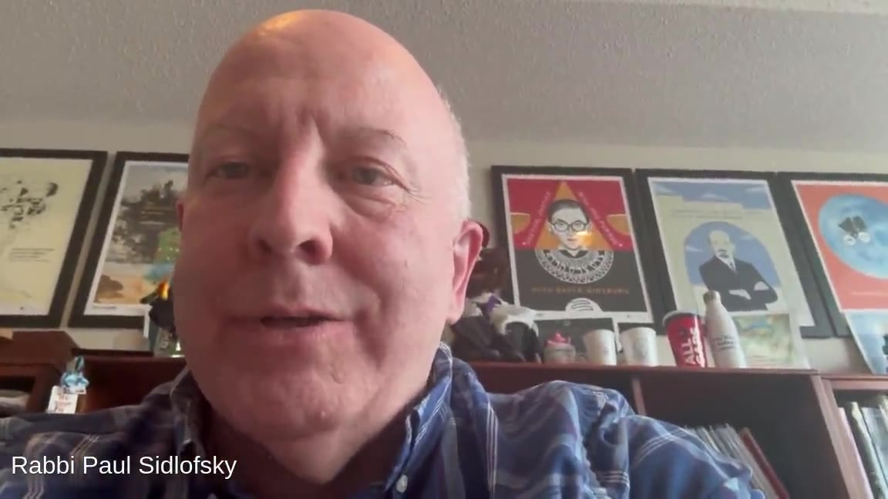
A MESSAGE FROM OUR THIRD FOUNDING CO-CHAIR
Rabbi Paul Sidlofsky
Founding Co-Chair, 2001 · now serving a congregation in the United States
Click to play · 2 min 59 s
Notes:
SPEAKER: AQ — set the video up in one sentence, then play it.
Our third founding Co-Chair, Rabbi Paul Sidlofsky, is now serving a congregation in the United States. He could not be with us this morning, so he sent this.
Runtime 2 minutes 59 seconds. Click the picture to play. Check the room audio before the session starts.

Slide 24
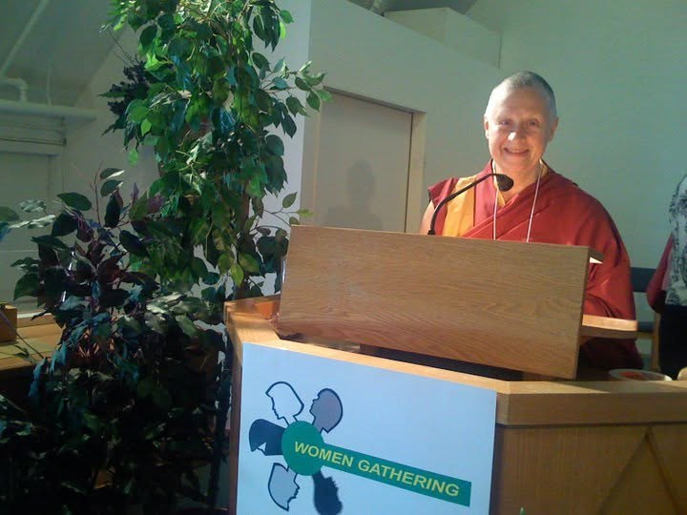
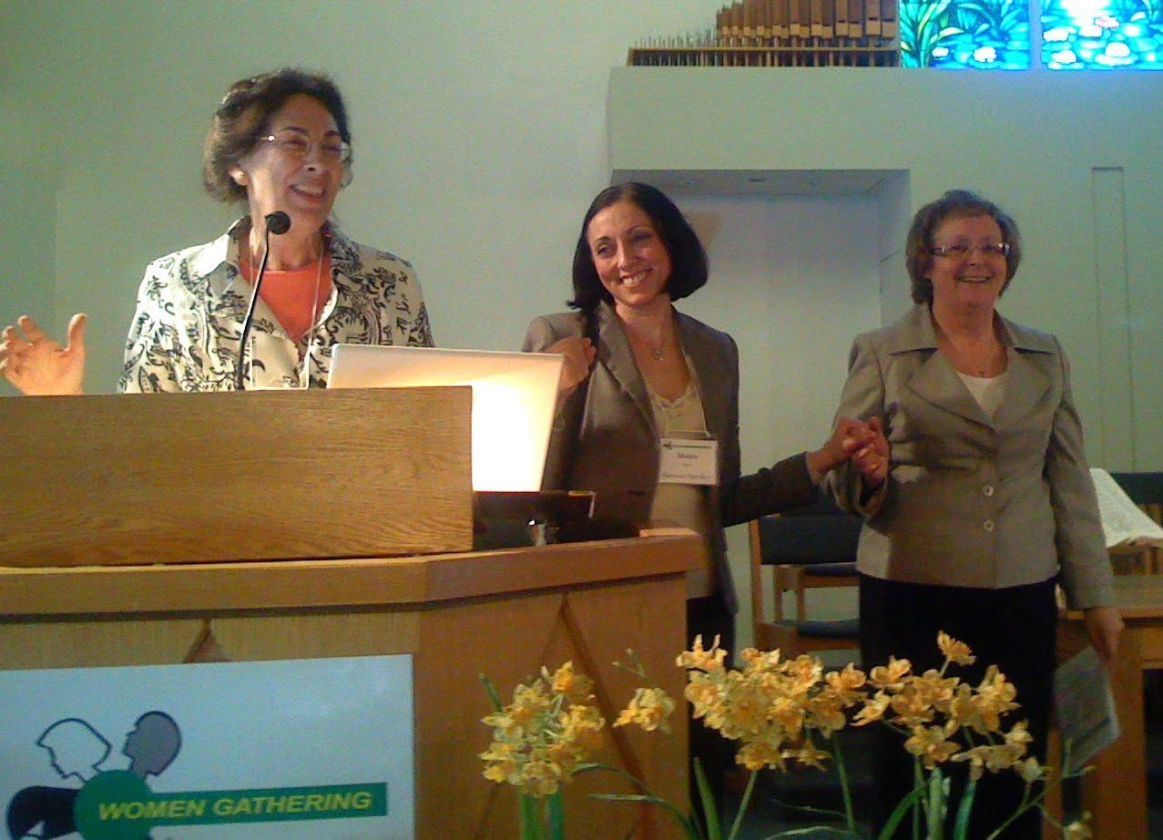
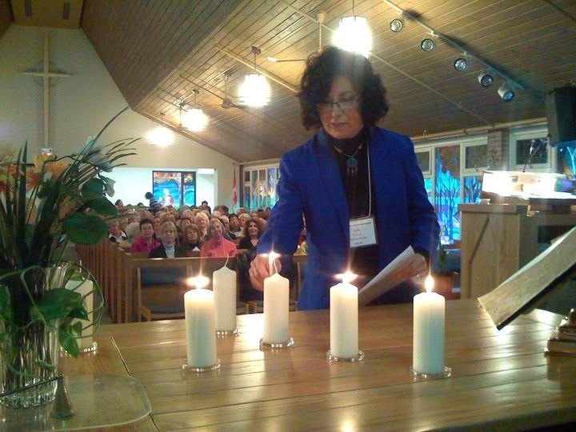
ALONGSIDE THE COUNCIL
Womengathering
Lottie Grant and Ann Mulvale sparked the creation of Womengathering — biennial events where women learn about their neighbours’ faiths and hear remarkable guests’ stories.
They raise money too — a scholarship for an Indigenous woman at Laurentian University among them.
Speakers include Laila Eriksson, chair of the Halton Multicultural Council and a founding member of the Council — independent of us, but a crossover well worth celebrating.
Notes:
SPEAKER: MÒRAR — about 1 minute. This slide replaces the blank one.
Lottie Grant and Ann Mulvale sparked the creation of Womengathering — biennial events where women learn about their neighbours' faiths and hear remarkable guests' stories, and raise money for important causes, like a scholarship for an Indigenous woman at Laurentian University.
The celebration highlights speakers such as Laila Eriksson, chair of the Halton Multicultural Council and a founding member of the ICH. Although it is independent of the ICH, the significant crossover makes it worth celebrating.

Slide 25
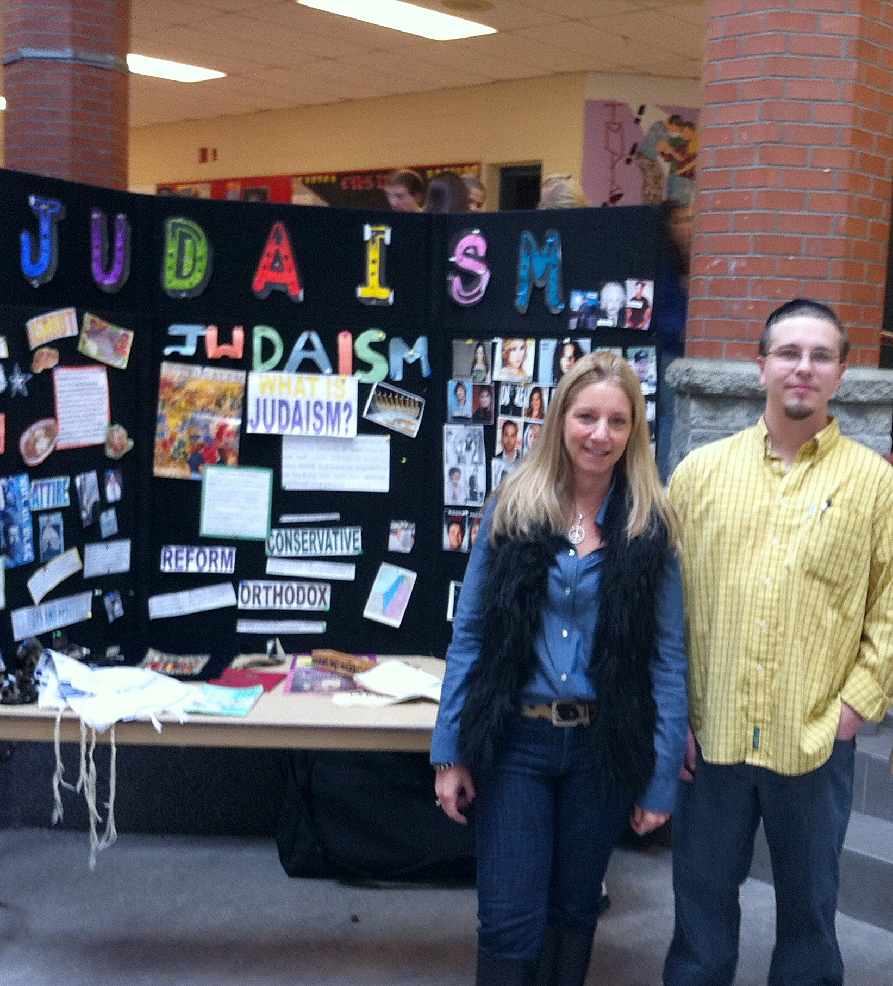
OUR FIRST ACT — AND STILL OUR LARGEST
The Interfaith Youth Festival
The first
Ten students from each high school in the region — and Michael “Pinball” Clemons as keynote speaker.
Then
Instead of selecting students, we went into the schools with faith leaders: 400 to 500 students in a day.
With HRPS
A police Inspector, Jackie Gordon, assigned to the Council, helped secure our first, perhaps only, grant — the display boards for the booths.
Today
Still going into public and Catholic schools across the region.
Notes:
SPEAKER: AQ — your story, part 4. ~2 min.
Your own words (spelling corrected only):
"We were fortunate enough to have great support from HRPS. The then Inspector — now retired Sergeant-at-Arms at the Ontario Legislature — was assigned by HRPS to ICH, and became one of the most vocal supporters of ICH's mission. She helped us secure the first, and perhaps the only, grant, to purchase display boards for our booths at the Interfaith Youth Festival (IYF).
In the very first IYF, we invited 10 students from each high school in the region and had Pinball Clemons as our keynote speaker. After its huge success, instead of selecting students we started going into the schools with faith leaders. Through this approach, we meet 400 to 500 students in a day."
→ Say her name here. It was not in your account, so it is not on the slide.

Slide 26
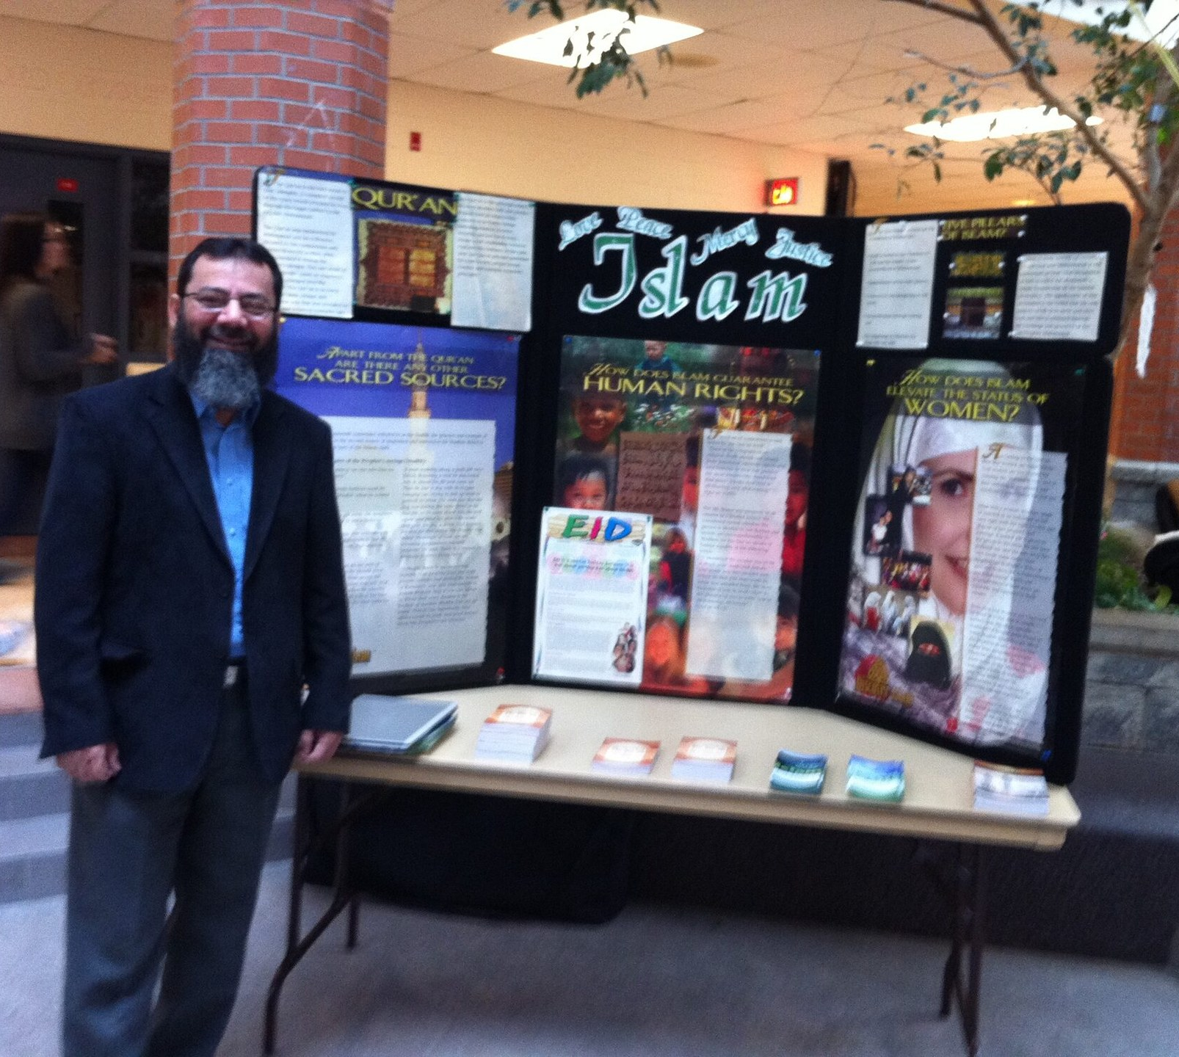
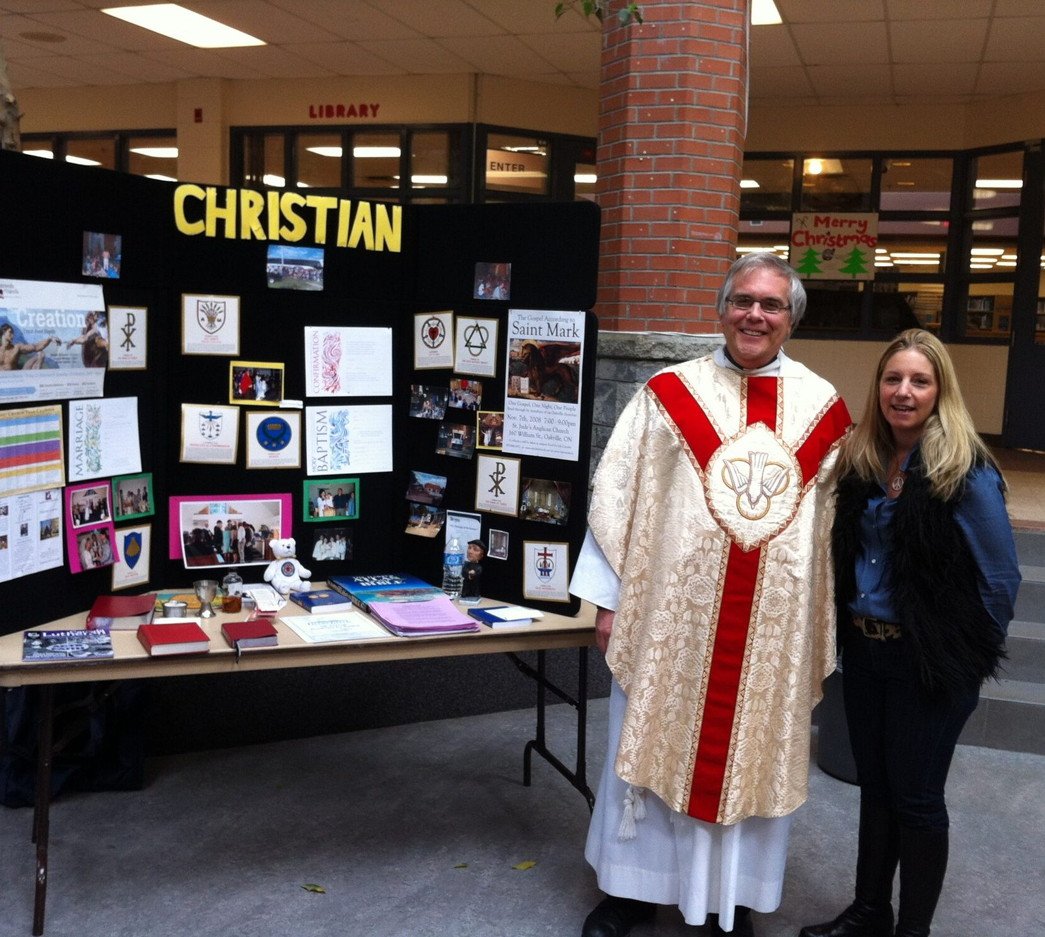
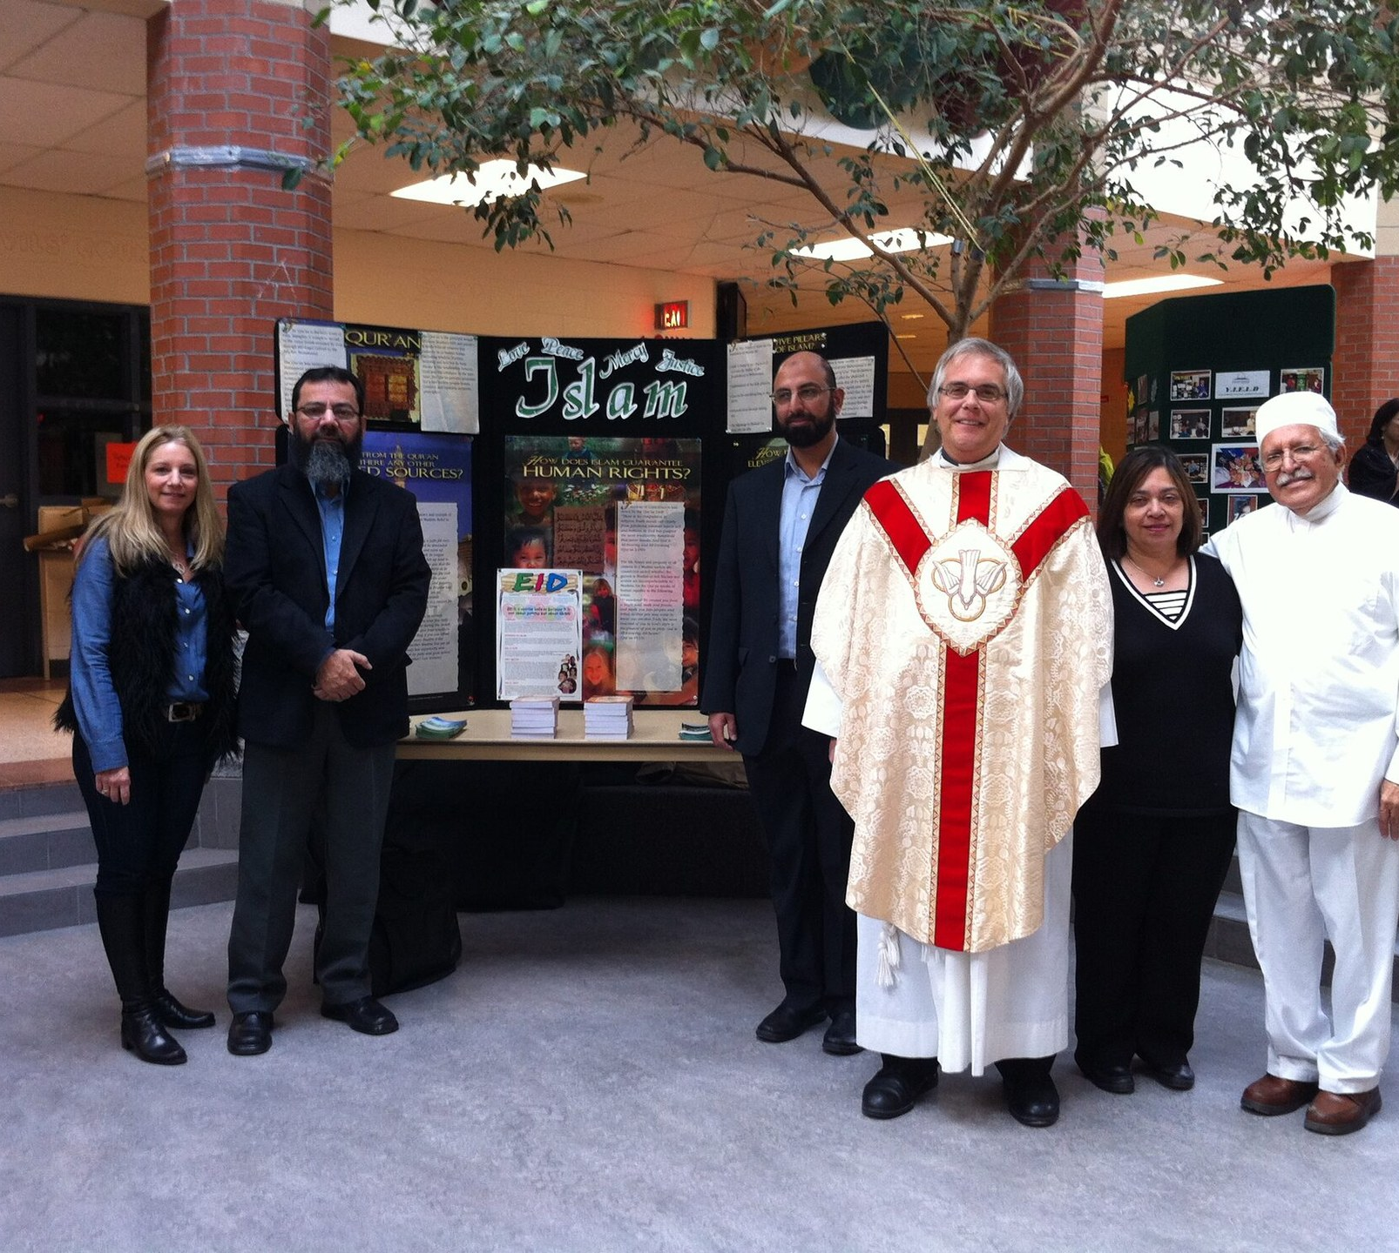
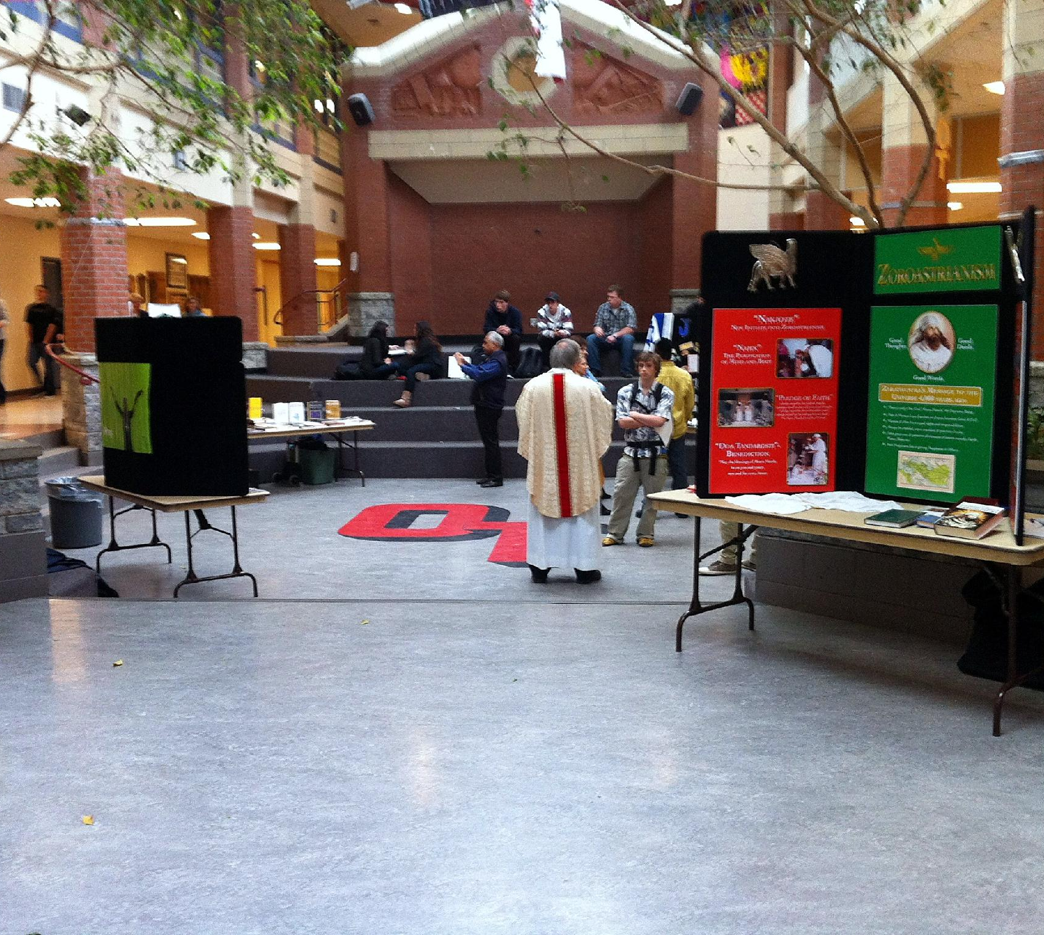
HOW A FESTIVAL DAY WORKS
One passport, every faith
85%+
improvement in students’ understanding of other faiths
1
2
3
4
The Interfaith Passport
At the booths
By day’s end
Town hall
A small booklet — the same questions for every faith.
Students circle round in groups and ask each faith its questions.
Every student holds an interfaith comparative study.
Open questions to a panel of faith leaders, in the auditorium.
Scientific surveys, before and after the programme
Notes:
SPEAKER: AQ — your story, part 5. ~2 min.
Your own words (spelling corrected only):
"We produced a small booklet called the Interfaith Passport. This booklet has the same questions to be asked of each faith. Students in groups circle around, meet the faith at the faith booth, and ask the questions for that faith. At the end of the day the students have an interfaith comparative study in their hands.
The program ends with an open town hall session in the school auditorium, where students freely ask questions of the panel of faith leaders.
We used to have scientific surveys of the students before and after the programs, and the results were astonishing, with students' understanding of other faiths improving over 85%."
Photos: Interfaith Youth Festival booths — the display boards the HRPS grant paid for.

Slide 27
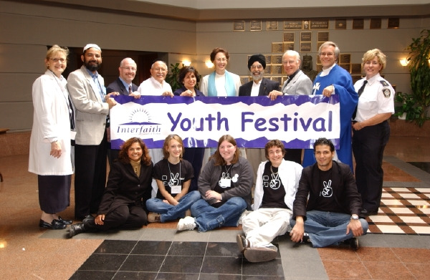
MÒRAR’S STORY
Conversations about things that matter
Imaginative ways to live creatively through changing times.
ICH members and Festival Youth Leaders.
Notes:
SPEAKER: Mòrar — your story, continued. ~1.5 min.
From your published introduction: "She loves engaging teens and young adults in conversations about things that matter to them." And: "Mòrar is called to explore imaginative ways we can live creatively through changing times."
From the History page: in December 2009 Mervyn Russell, Laila Eirksson, Stephen Wise, Donna Martin and Mòrar Murray-Hayes prepared the Council's constitution — decisions by consensus, "with care never to lose any faith group over a matter of conscience". Approved as a final draft for the September 2010 AGM.
Prompts: a moment with students you still remember; what young people ask that adults have learned not to.
Photo: a youth group at the Council's Interfaith Breakfast, April 2011.

Slide 28
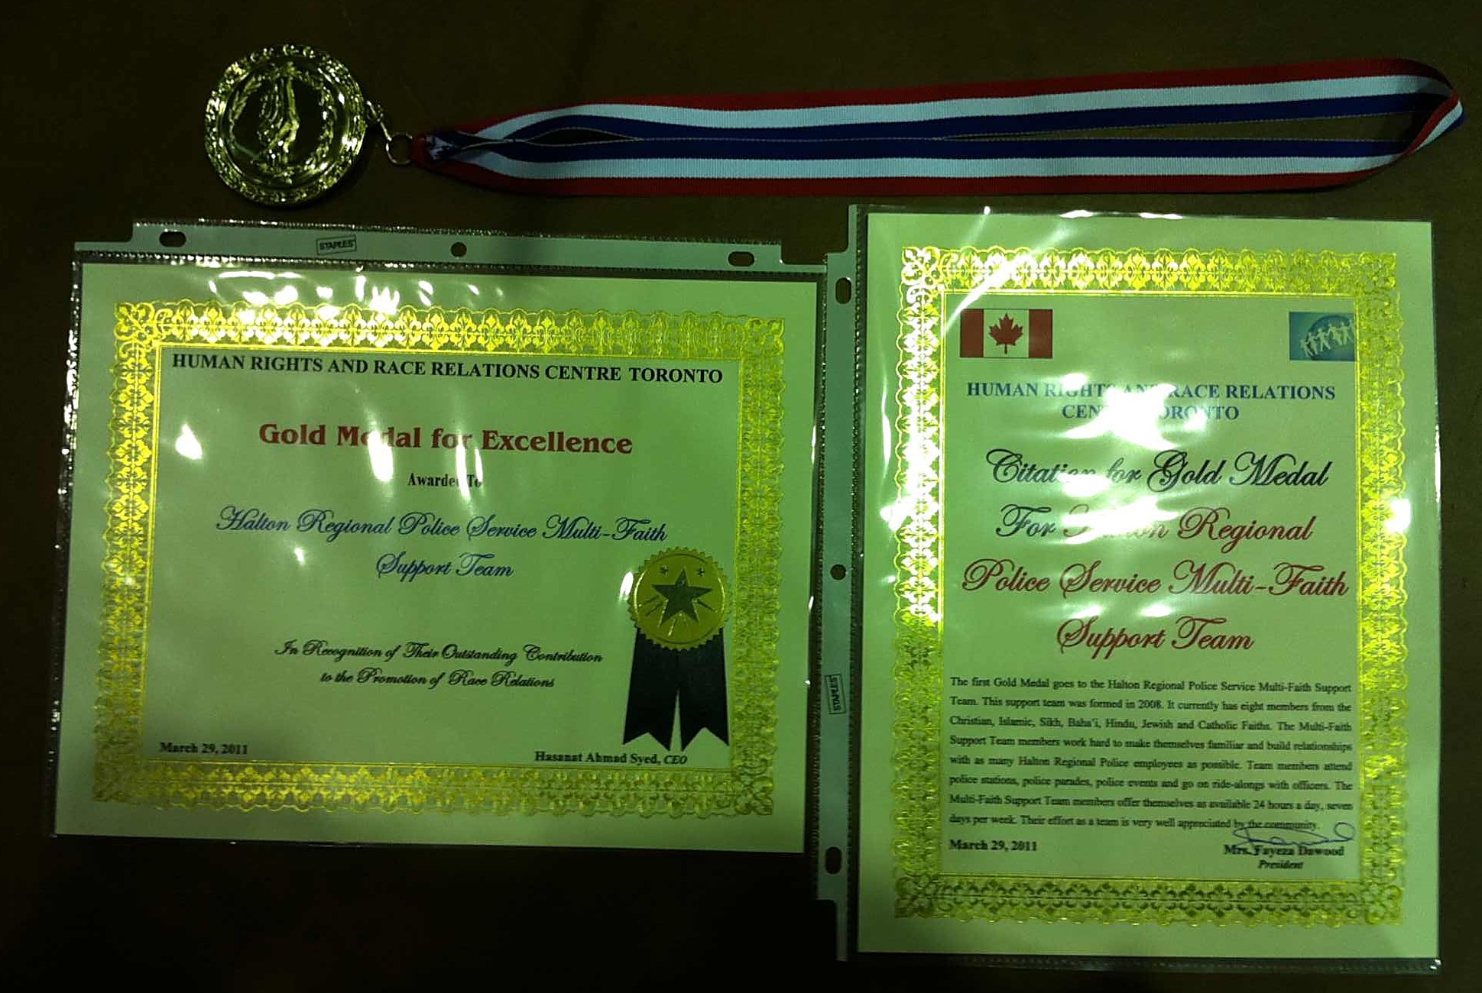
RECOGNITION
Two Gold Medals of Excellence
1
First, to the Council
For the Interfaith Youth Festival — the initiative behind that 85% rise in understanding.
2
Then, 29 March 2011
To the HRPS Multi-Faith Support Team, on which the Council sits — after police studies found crime went down where we held the festival.
The medal, the certificate and the citation, 29 March 2011.
Human Rights and Race Relations Centre, Toronto
Notes:
SPEAKER: AQ — your story, part 6. ~1.5 min.
Your own words (spelling corrected only):
"Because of this initiative we received our first Gold Medal of Excellence for Human Rights. Similarly, HRPS conducted studies in the region and found that where we conducted the IYF, the crime rate went down in those areas. Hence, we received our second Gold Medal. This IYF continues till today, going into both public and Catholic schools in the region."
Confirmed by you, 21 Sep 2026: the award went first to ICH, then to the MFST. The History page and the Youth Festival page now say the same.
The 2011 citation: "In recognition of their outstanding contribution to the promotion of race relations."
Photo: the whole medal, certificate and citation are now shown.

Slide 29
TWENTY-FIVE YEARS
Some of the moments that show what we are for
2001
2001
Soon after
2006
2009
2011
Together We Stand, and Together We Celebrate
First meeting, at Town Hall
First Interfaith Youth Festival
Regional/municipal OPA negotiations for faith-group rights begin.
Meeting at Al-Falah; a constitution is written
The Interfaith Breakfast
2015
2017
2018
2020–21
2025
2026
Abraham’s Children welcome a Syrian family
“Circles of Peace” after Quebec City
Halton’s first Interfaith Peace Camp
Meeting through the pandemic, online
In Halton Catholic school classrooms
Fasting, and what it teaches
Notes:
SPEAKER: pick three or four of the twelve. Not all of them.
TO DO — “Zoning Change” was typed into this slide's title. It is not a timeline entry yet: give the year and one line of text and it can be added to the row properly.

Slide 30
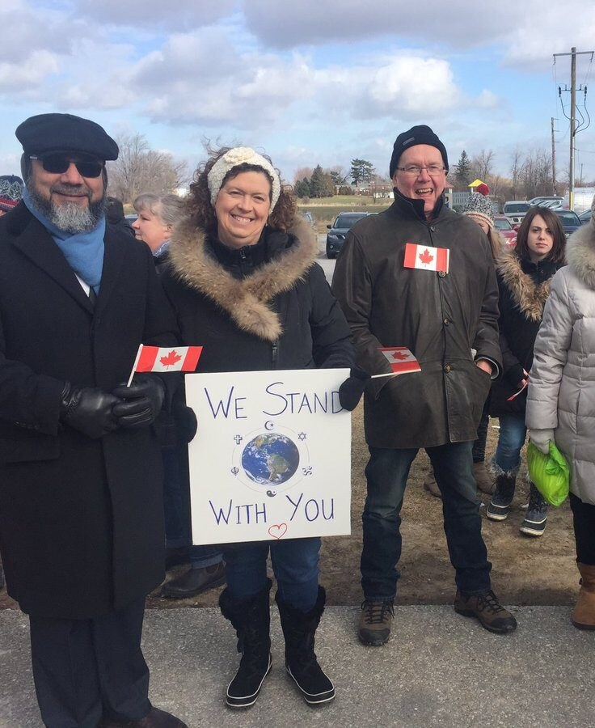
IN PUBLIC, WHEN IT HURTS
Standing together
2014
Vigil in Oakville for the children killed at the Peshawar school
2016
Oakville pays tribute to the victims in Orlando
After Quebec City: a circle outside the Al-Falah Islamic Centre while Muslims prayed inside
2017
2018
After Pittsburgh: Prayer inside Shaarei-Beth El Congregation
2022
Prayers for peace in Ukraine
2023
Prayers for Peace outside Oakville Town Hall
Nobody had to be persuaded to come.
Notes:
SPEAKER: AQ. ~1.5 min.
February 2017: after the Quebec City mosque shooting, an interfaith circle gathered outside the Al-Falah Islamic Centre while Muslims prayed inside. Dignitaries, clergy and neighbours stood in the cold with hand-lettered signs. More than a hundred people; the banner read "We stand with you". CHCH News covered it, and the Toronto Star reported rings of peace forming around mosques across the region.
28 October 2023: "As war deepened in the Middle East, the Council called a public rally for peace outside Oakville Town Hall. People of every faith in Halton stood together on the forecourt."
The Council's own line: "When events far away wound people here, the Council's answer is to stand together in public."

Slide 31
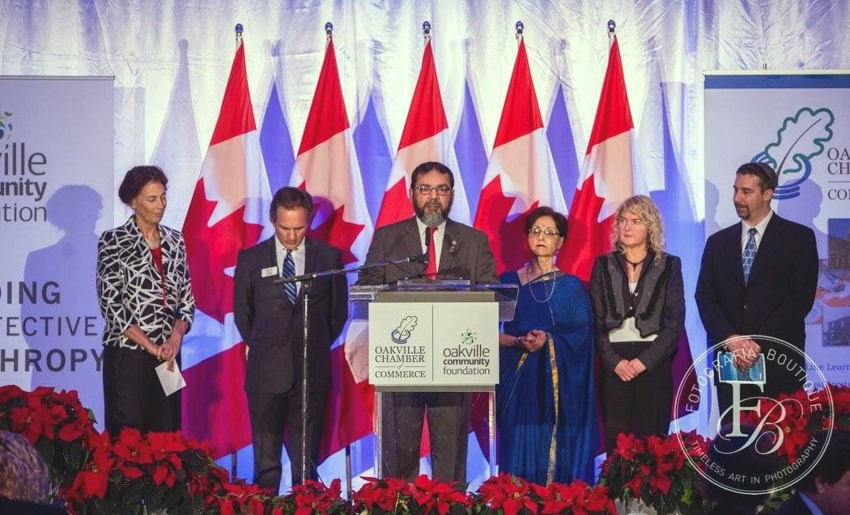
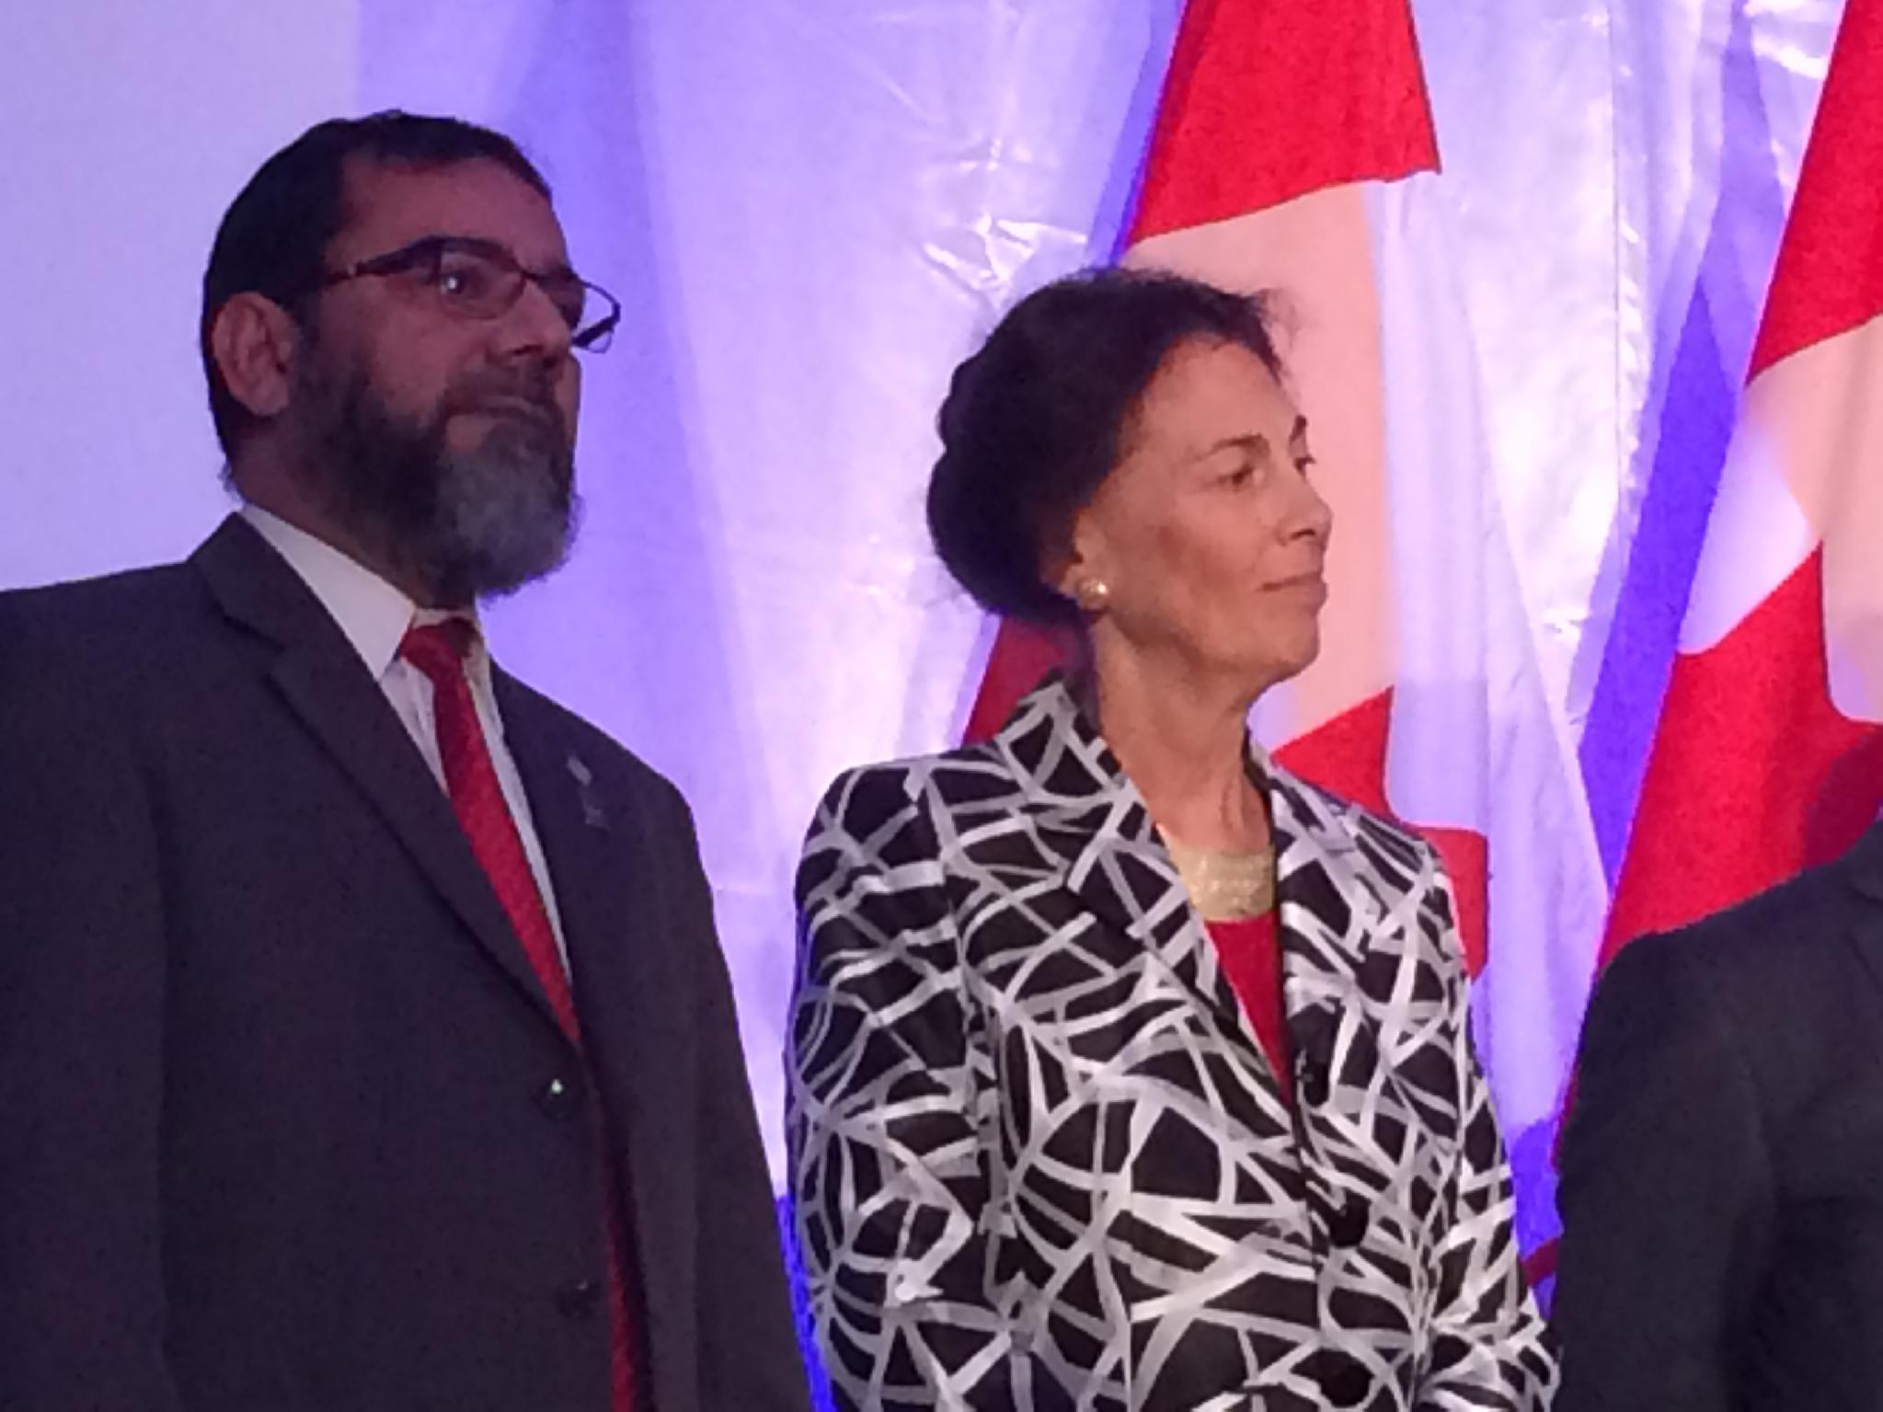
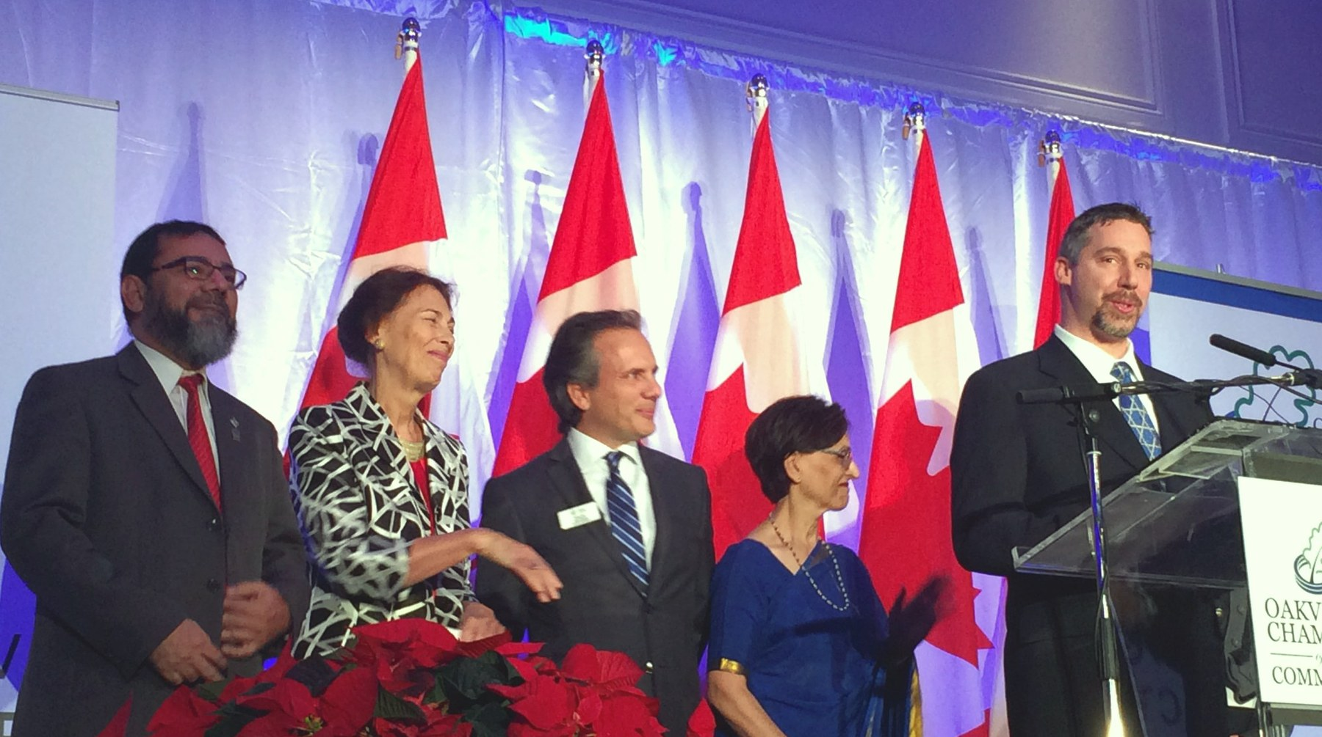
15 DECEMBER 2015 · OAKVILLE CHAMBER OF COMMERCE
Speaking for our faiths
Council leaders on stage, each speaking for their own tradition. Photograph: Fotografia Boutique.
Notes:
SPEAKER: AQ. ~1 min.
15 December 2015 (from the photographs' own timestamps). A programme hosted by the Oakville Chamber of Commerce with the Oakville Community Foundation — both logos are on the podium. Leaders of the Council took the stage together and each spoke for their own faith.
Prompts: what the occasion was, and who spoke for which tradition. Nobody but you is named on the slide, because the photographs alone cannot say who everyone is.
The large photograph is by Fotografia Boutique — their watermark stays, and the credit is on the slide.

Slide 32
DECEMBER 2015 · REFUGEE SPONSORSHIP
Abraham’s Children
Maple Grove United Church
Shaarei-Beth El Synagogue
CSRDN Muslim group
One family from Syria
Three traditions, one family, one undertaking.
Jews, Christians and Muslims all trace their faith to Abraham — and all three scriptures command hospitality to the stranger.
Notes:
SPEAKER: Mòrar. ~1.5 min.
From the Refugee Sponsorship page: Abraham's Children was formed as a project of the Interfaith Council of Halton by three communities acting together — Maple Grove United Church, Shaarei-Beth El Synagogue and the CSRDN Muslim group. In December 2015 they welcomed a family of refugees from Syria and supported them through their first year in Canada.
"The name was chosen deliberately... Sponsoring one family together said something that three separate sponsorships would not have."
"It is not paperwork. It is company." — enrolling children in school, finding a doctor, opening a bank account, learning a bus route, getting through a first Canadian winter.

Slide 33
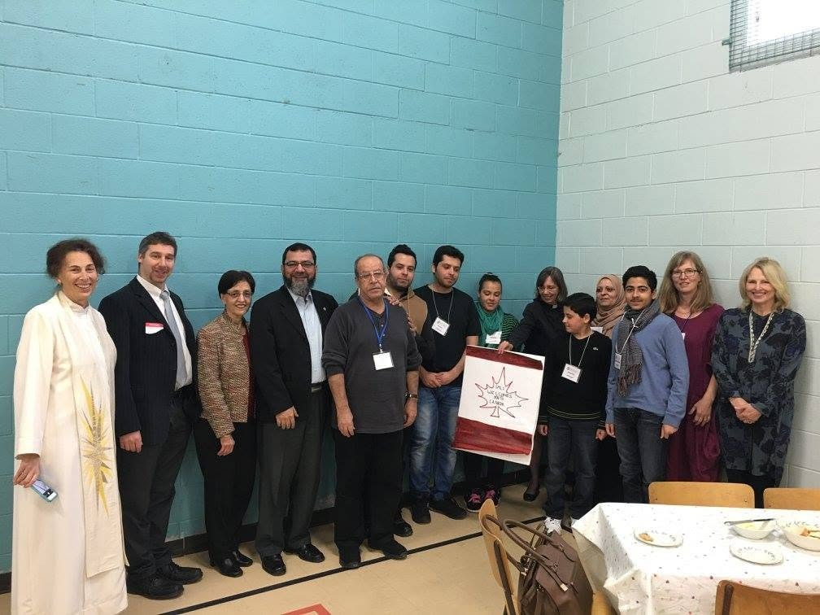
ABRAHAM’S CHILDREN · THE TEAM
“How can we help?”
Dr. Aliya Khan, of the ICNA mosque, and Heather Donaldson, of Maple Grove United Church, asked the question that started it.
Sandra Onufryk and Katy Joaquim led the Oakville interfaith team.
A joint effort, featured by the Toronto Star and WSNBC.
The family, with the leaders who brought them here
Notes:
SPEAKER: MÒRAR or AQ — about 1 minute, straight after Abraham's Children.
Dr. Aliiya Khan of the ISNA mosque and Heather Donaldson of Maple Grove United Church asked 'how can we help?'. Sandra Onufryk and Katy Joaquim led our Oakville interfaith team. It was a joint effort, and it was featured by the Toronto Star and WSNBC.
CHECK: 'WSNBC' is as written in the companion — confirm the outlet before saying it aloud.

Slide 34
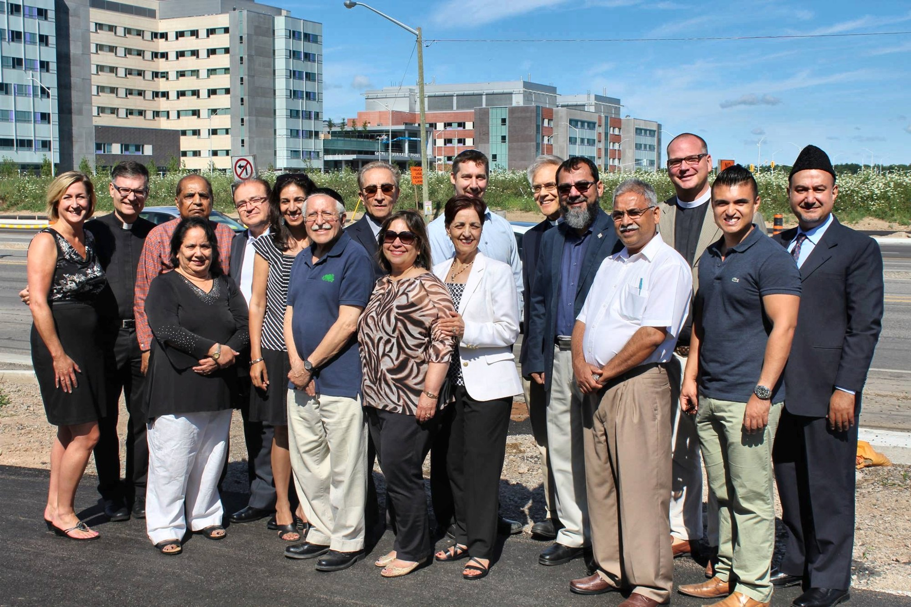
BEYOND OUR OWN WALLS
For the whole community
$150,000
raised by members of the Council for Oakville’s new hospital.
A hospital serves every faith, and none.
Council members outside the new Oakville Trafalgar Memorial Hospital.
Notes:
SPEAKER: AQ. ~1 min.
From your note: ICH members in front of the Oakville hospital while raising $100,000 for the hospital. The building in the photograph is the new Oakville Trafalgar Memorial Hospital — its name is legible on the façade.
Prompts: when the campaign ran, and which communities took part. The year is not recorded, so it is not on the slide.
Also on the website now: the Photo Gallery's 'Council and community' album.

Slide 35
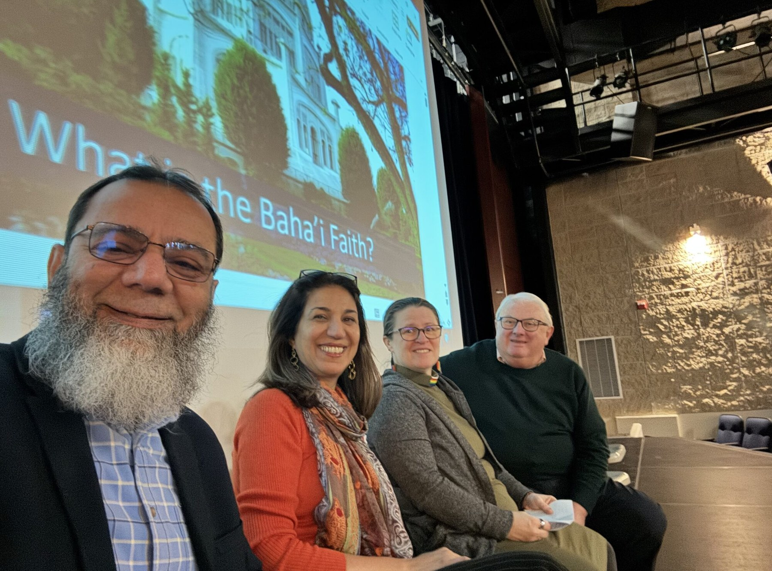
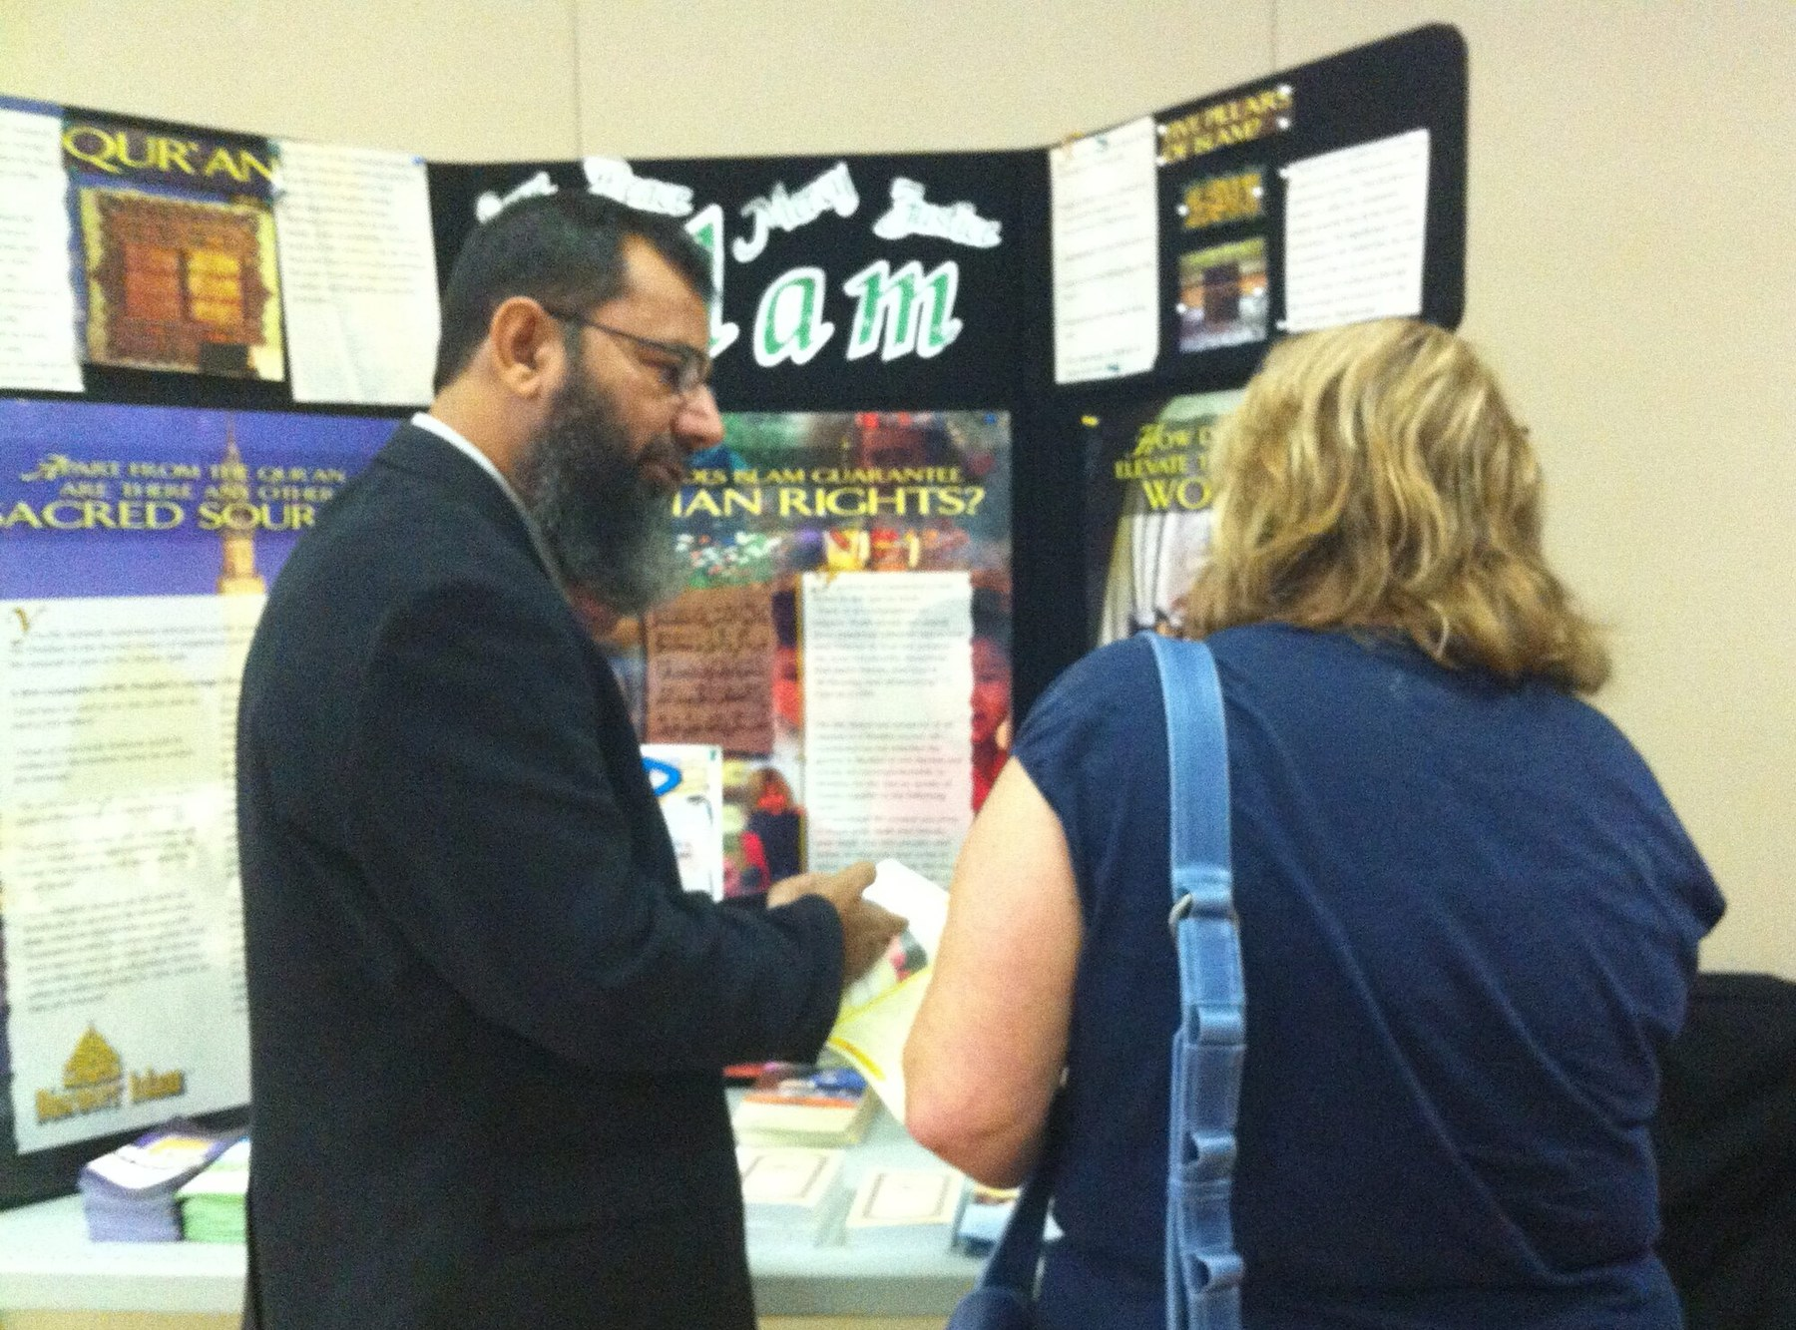
STARTING EARLY
Interfaith Peace Camp
Children and Youth leaders skip the books to learn about other faiths directly from people—and they can't wait to return!
Halton schools, November 2025
Interfaith Youth Festival
“Understanding is easiest to build before there is anything to undo.”
Notes:
SPEAKER: Mòrar. ~1.5 min.
From the Peace Camp page: one week, 9 to 4, lunch provided, a modest fee kept deliberately low; children of every faith and of none. "Adults arrive at interfaith work carrying a lifetime of assumptions to be unpicked. Children do not." And: "a friendship formed at eight years old does more for a community twenty years later than any amount of adult dialogue."
From the Youth Festival page: "Halton is changing quickly... What has made Halton different is the level of cooperation between its communities — and that is not self-sustaining. It is built, deliberately, one generation at a time."

Slide 36
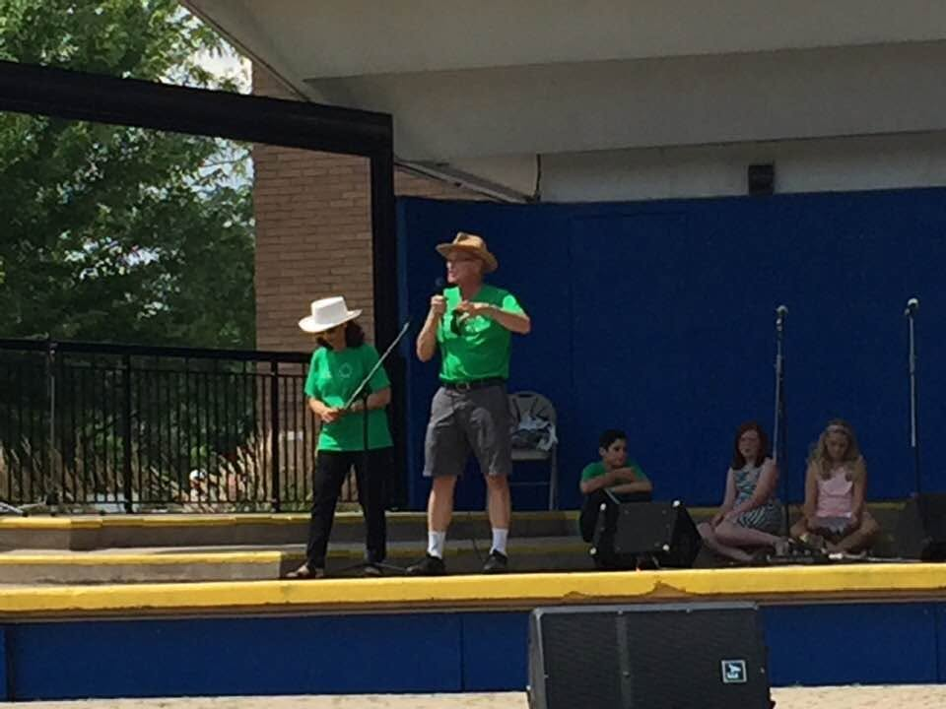
STARTING EARLY
Interfaith Peace Camp
Notes:
SPEAKER: Mòrar. ~1.5 min.
From the Peace Camp page: one week, 9 to 4, lunch provided, a modest fee kept deliberately low; children of every faith and of none. "Adults arrive at interfaith work carrying a lifetime of assumptions to be unpicked. Children do not." And: "a friendship formed at eight years old does more for a community twenty years later than any amount of adult dialogue."
From the Youth Festival page: "Halton is changing quickly... What has made Halton different is the level of cooperation between its communities — and that is not self-sustaining. It is built, deliberately, one generation at a time."

Slide 37
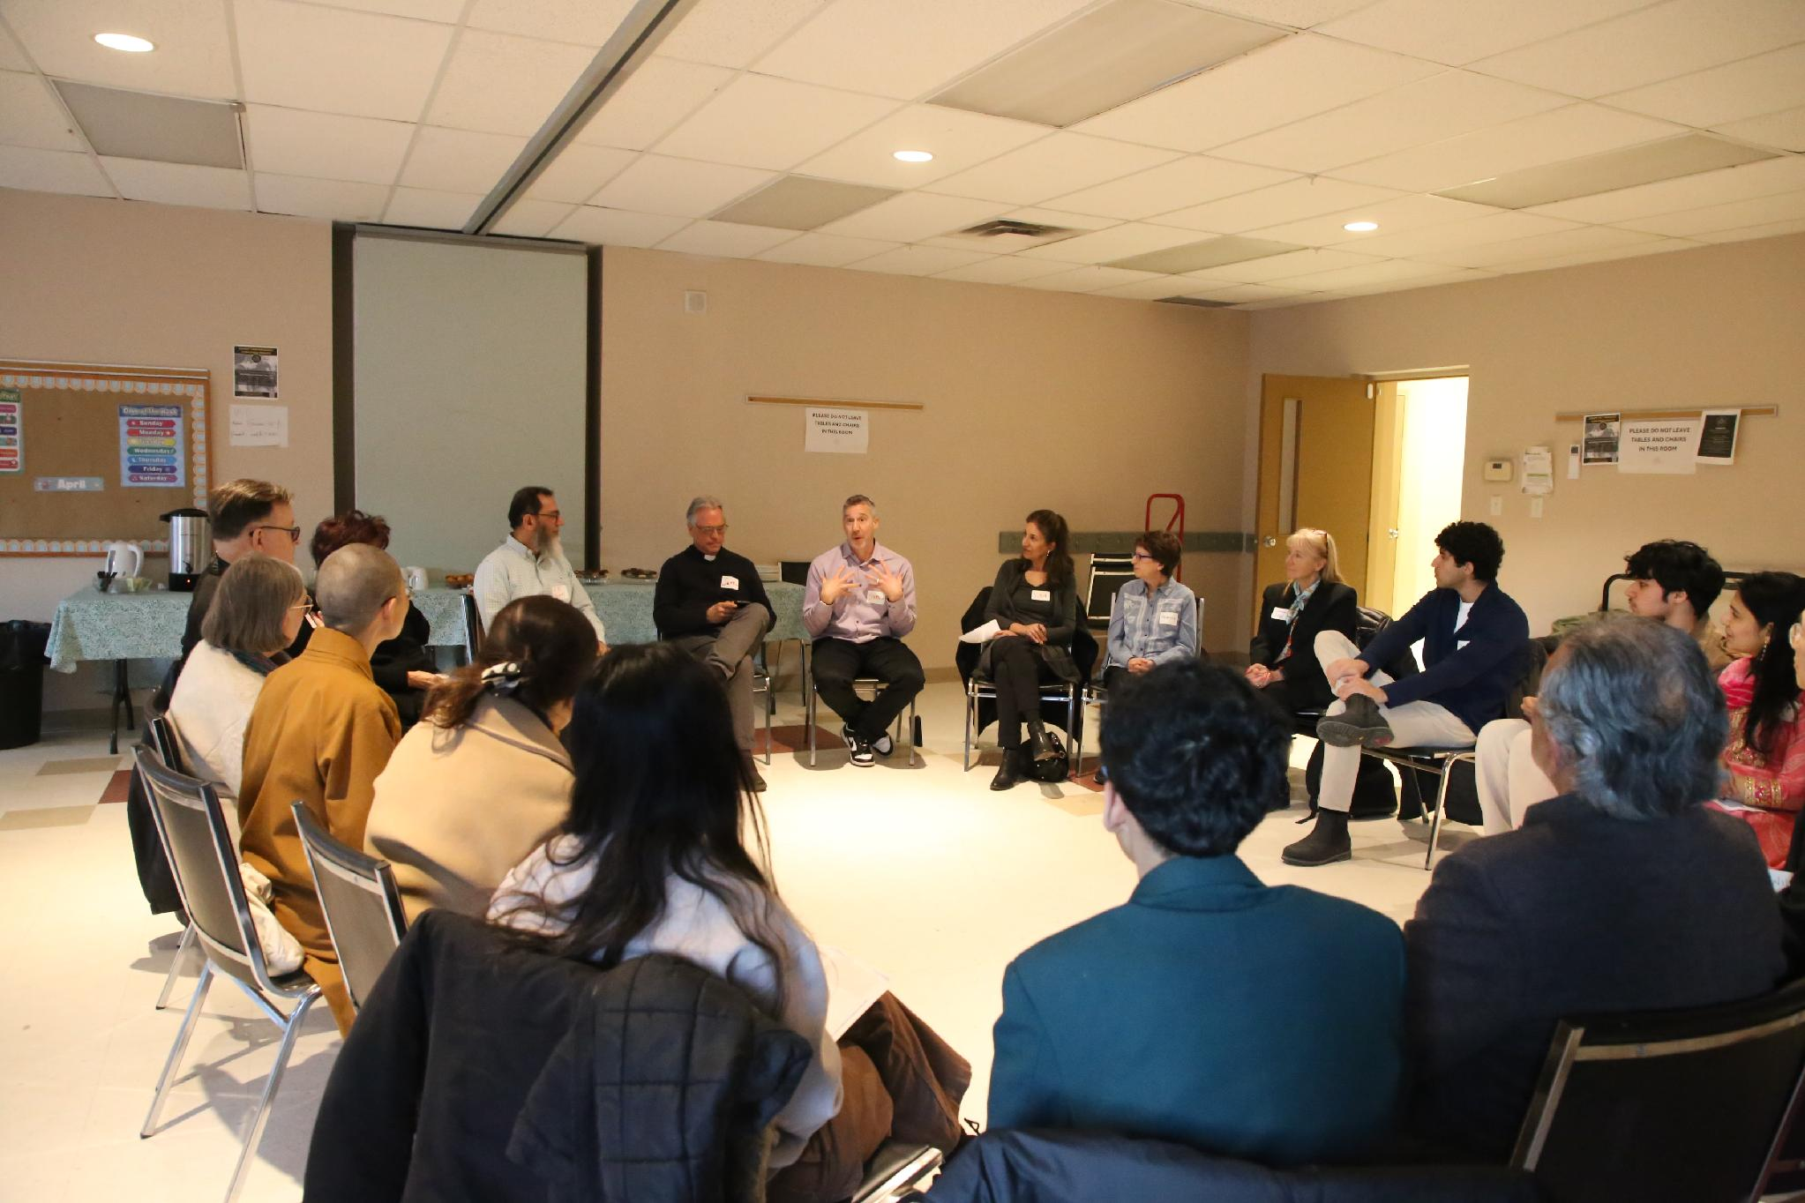
TWENTY-FIVE YEARS OF LEARNING
What we have learned
1
The essence of our core values is the same.
2
Understanding does not require agreement. It requires presence.
3
Being a guest somewhere unfamiliar does more than just talk about it.
4
Start with the young. It is easiest before there is anything to undo.
5
Cooperation is not self-sustaining. It is built, one generation at a time.
Notes:
SPEAKERS: Mòrar leads, AQ adds one of his own. ~2 min.
Each lesson is the Council's own published sentence:
1. "Despite the many different practices and rituals of our faiths, the essence of our core values is the same." (Homepage)
2. "Understanding does not require agreement. It requires presence." (Interfaith Dialogue)
3. "Being a guest somewhere unfamiliar does more for understanding than any amount of talking about it." (Interfaith Dialogue)
4. "Understanding is easiest to build before there is anything to undo." (Peace Camp)
5. Cooperation "is not self-sustaining. It is built, deliberately, one generation at a time." (Youth Festival)
AQ — this is a natural place to add the lesson that has mattered most to you personally.
Photo: April 2026 — members sharing how their traditions fast (Ramadan, Lent, Yom Kippur, Ekadashi, Uposatha) and what each learns from going without.

Slide 38
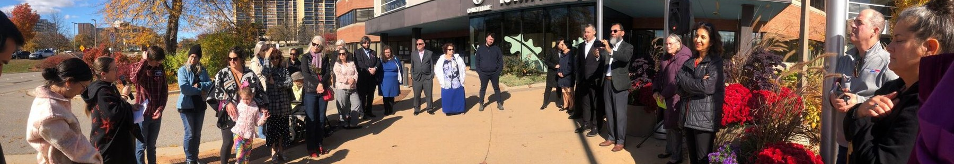
IMPACT
From tolerating difference, to accepting it, to embracing it
400–500
85%+
Lower crime
2
students met in a single festival day
rise in understanding of other faiths
where the festival was held, per HRPS studies
Gold Medals for Excellence
Notes:
SPEAKER: AQ. ~1.5 min. Photo: Prayers for Peace outside Oakville Town Hall, 28 October 2023.
Every figure on this slide is from your own account: 400 to 500 students in a day; understanding of other faiths improving over 85% in before-and-after surveys; HRPS studies finding crime went down where the IYF was held; two Gold Medals.
Beyond the numbers, from the record:
• A standing relationship with Halton Regional Police — the Multi-Faith Support Team.
• A Syrian family welcomed by a church, a synagogue and a mosque acting as one.
• When Quebec City, Orlando, Peshawar, Ukraine and the Middle East wounded people here, neighbours had somewhere to stand together.
The headline is from the Youth Festival page.

Slide 39
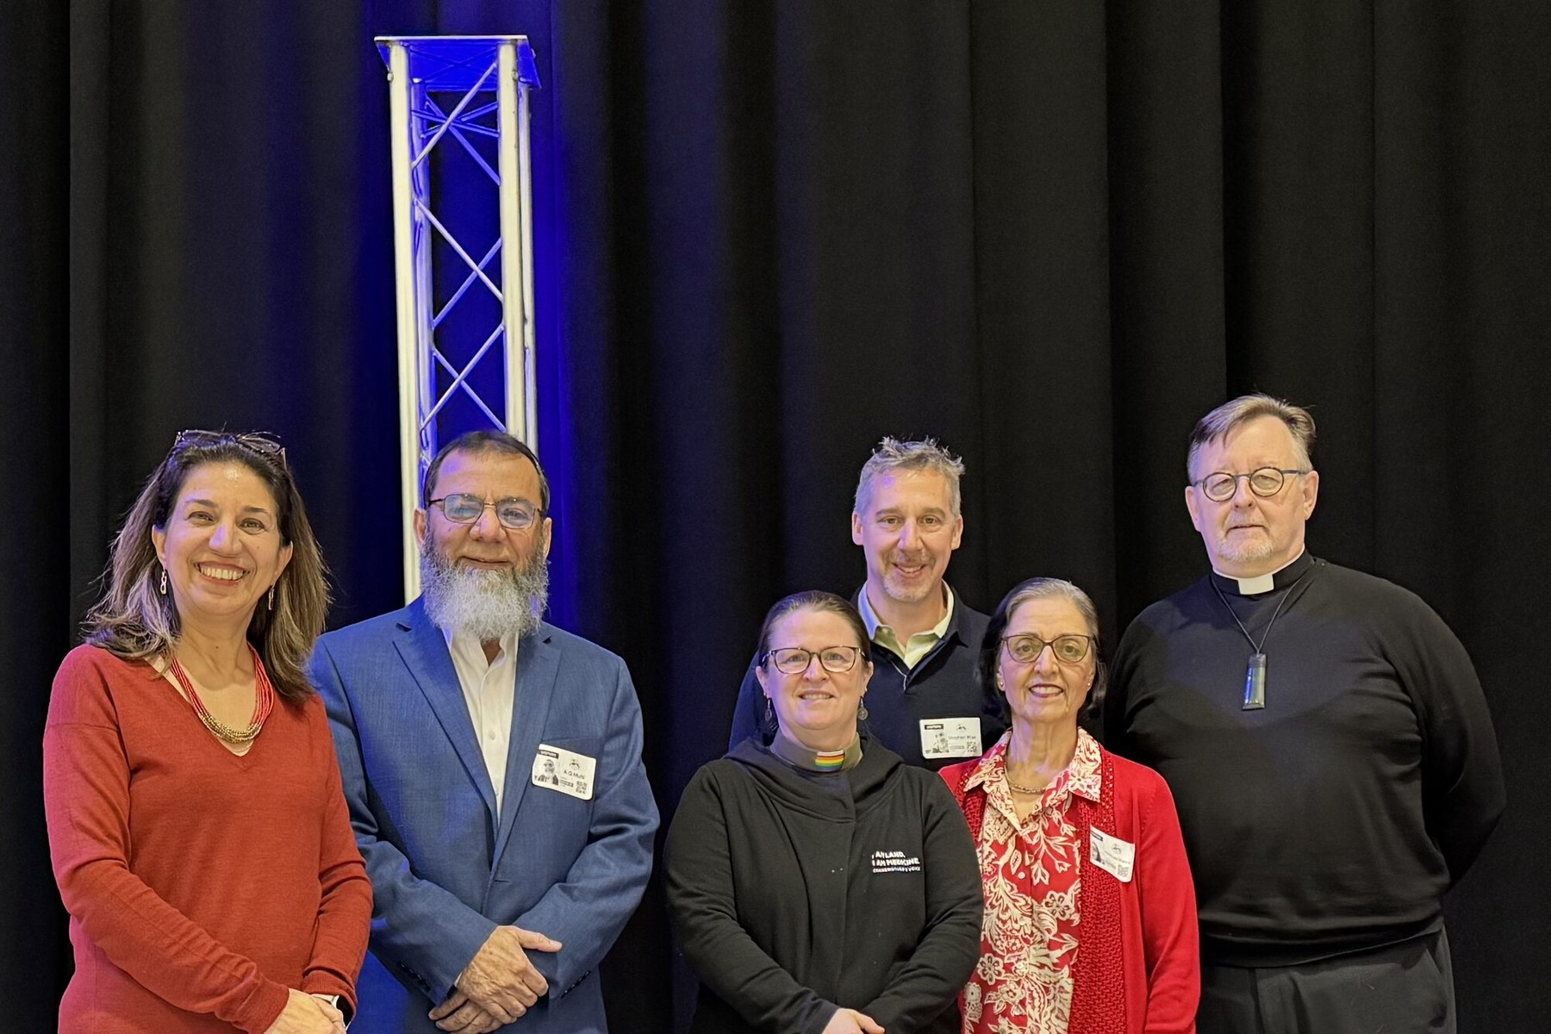
STILL GOING
The work continues
The Council still meets, still listens, and still turns up when a community in Halton is grieving or afraid.
Membership is open to authorised representatives of any faith, religious or spiritual group in the Region of Halton.
Vida Rosen · Imam Abdul-Qayyum Mufti · Rev. Deborah Laforet ·
Rabbi Stephen Wise · Pravin Lata Sharma · The Rev. Malcolm French SCP
Notes:
SPEAKERS: both. ~1 min.
The photo shows six of today's nine Council members, left to right: Vida Rosen (Secretary, Baháʼí Faith), Imam Abdul-Qayyum Mufti (Co-Chair), Deborah Laforet (Co-Chair, St. Paul's United), Rabbi Stephen Wise (Shaarei-Beth El), Pravin Lata Sharma (Hindu Faith), The Reverend Malcolm French scp (Treasurer, St. Simon's Anglican).
Not in the photo: Gillian Federico, The Venerable Jeff Ward, and Mòrar herself.
A good moment to thank Deborah Laforet as fellow Co-Chair, and every member of the Council by name if time allows.
Four ways in, from the Interfaith Dialogue page: speak at or host a gathering; bring the Council to a school; join the table; or simply come.

Slide 40

LOOKING BACK
THE ROAD AHEAD
“We feel humbled for what we have achieved — first our own self-improvement in understanding our fellow faith communities, and spreading the message of peace through learning, educating and understanding our fellow neighbours, and appreciating the diversity.”
“The road ahead is long. We will carry on this mission, and pass on the torch to whoever joins us in this journey of love, understanding, mutual respect, and spreading peace among our communities.”
Notes:
SPEAKER: AQ, then both. ~1.5 min.
Your own words (spelling corrected only):
"When we look back 25 years in the making, we feel humbled for what we have achieved, first of our own self-improvement of understanding of our fellow faith communities, in addition to spreading the message of peace through learning, educating, and understanding of our fellow neighbours and appreciating the diversity.
The road ahead is long; we will carry on this mission and pass on the torch to whoever joins us in this journey of love, understanding, mutual respect, and spreading peace among our communities."
The slide shortens the first quote slightly; read the full version from here.

Slide 41
Table Stories
What should be the primary goal of interfaith dialogue, and why is it important? (If applicable, please share your memories of working with the Interfaith Council.)
How can we inspire curious, open learning about different faiths to reveal shared values and foster unity?
Notes:
SPEAKERS: both. ~1 min.
Close together. Thank the guests, the Thomas Merton Centre, and everyone who has sat at the table over twenty-five years.
"Our public events are open to everyone, of any faith or none. You do not need an invitation and you will not be asked to believe anything."
Only the Council's website and its institutional meeting place are shown — no personal email addresses or telephone numbers, per the Council's standing rule.

Slide 42
Closing Prayers
Notes:
SPEAKERS: both. ~1 min.
Close together. Thank the guests, the Thomas Merton Centre, and everyone who has sat at the table over twenty-five years.
"Our public events are open to everyone, of any faith or none. You do not need an invitation and you will not be asked to believe anything."
Only the Council's website and its institutional meeting place are shown — no personal email addresses or telephone numbers, per the Council's standing rule.

Slide 43
Everyone is welcome at the table
Thank you for twenty-five years.
interfaithcouncilhalton.com
We meet at various places of worship in Halton Region
Notes:
SPEAKERS: both. ~1 min.
Close together. Thank the guests, the Thomas Merton Centre, and everyone who has sat at the table over twenty-five years.
"Our public events are open to everyone, of any faith or none. You do not need an invitation and you will not be asked to believe anything."
Only the Council's website and its institutional meeting place are shown — no personal email addresses or telephone numbers, per the Council's standing rule.

